Slide 1
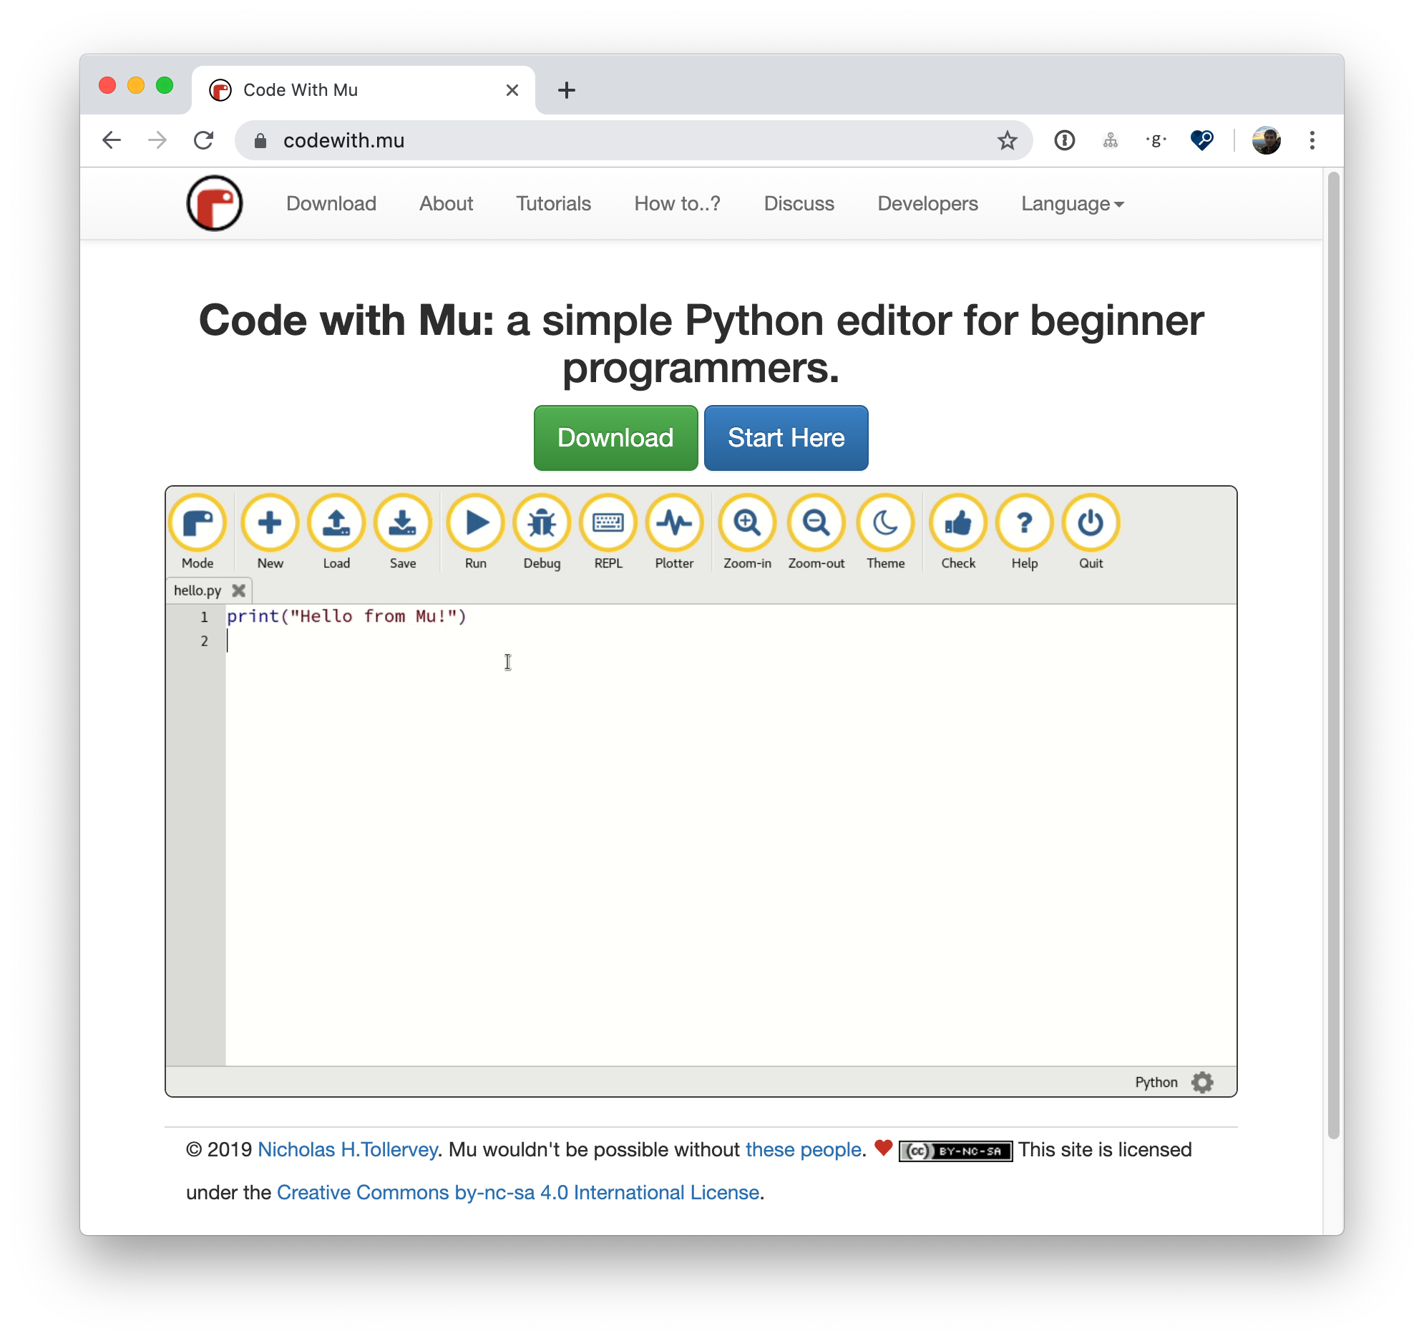
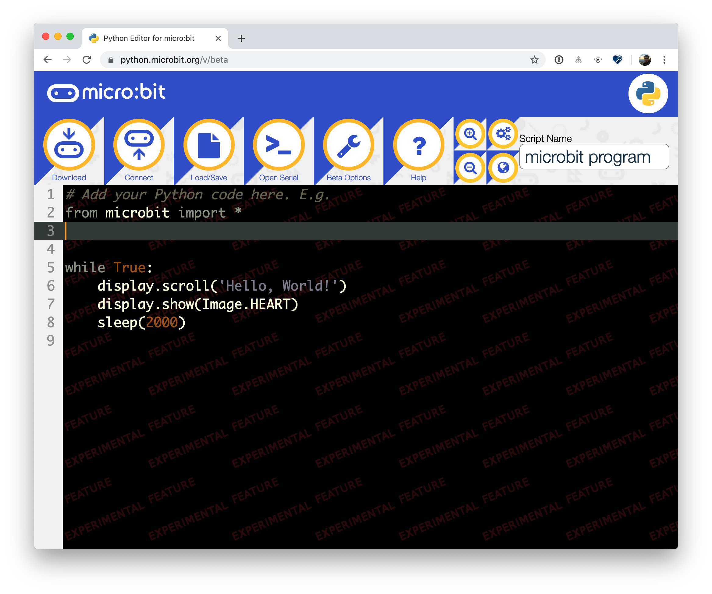
Software You’ll Need
Install Mu:
https://codewith.mu/
Online Editor (with Chrome):
https://python.microbit.org/v/beta
OR

Slide 2



Hardware Drivers in
MicroPython
CARLOS PEREIRA ATENCIO
Software Engineer @ .
@carlosperate

Slide 3
Outline
Short-ish Presentation:
MicroPython
How to drive hardware
Communicating with other devices
Hardware documentation
Writing some code
Debugging
Workshop!

Slide 4
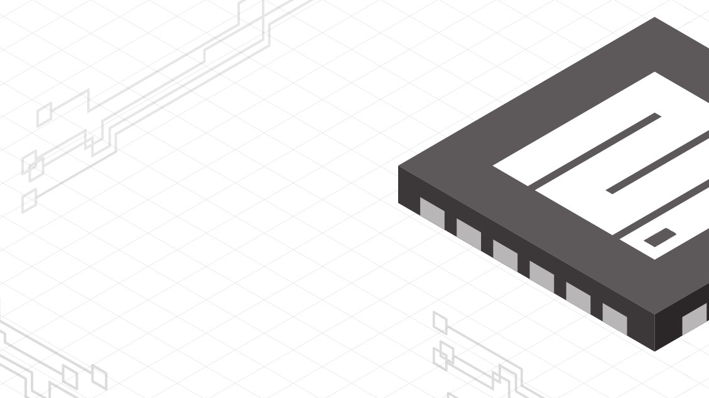
MicroPython
Lean and efficient Python 3 implementation
Can run in 16KBs RAM, 256KBs ROM
Includes parser, compiler and virtual machine
Small subset of the standard library
Available in a wide range of platforms

Slide 5
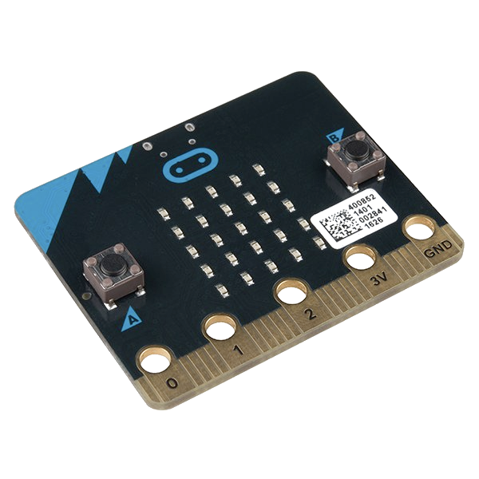
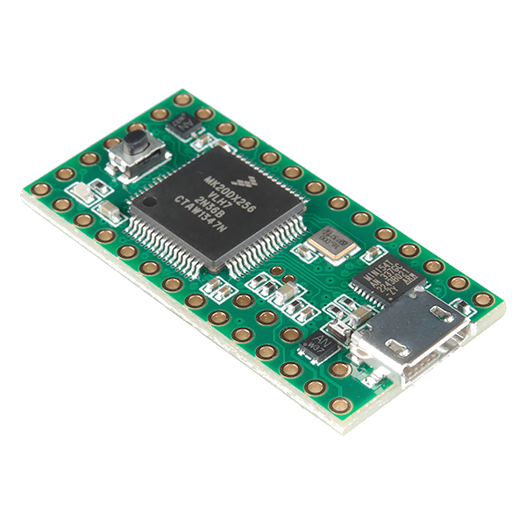
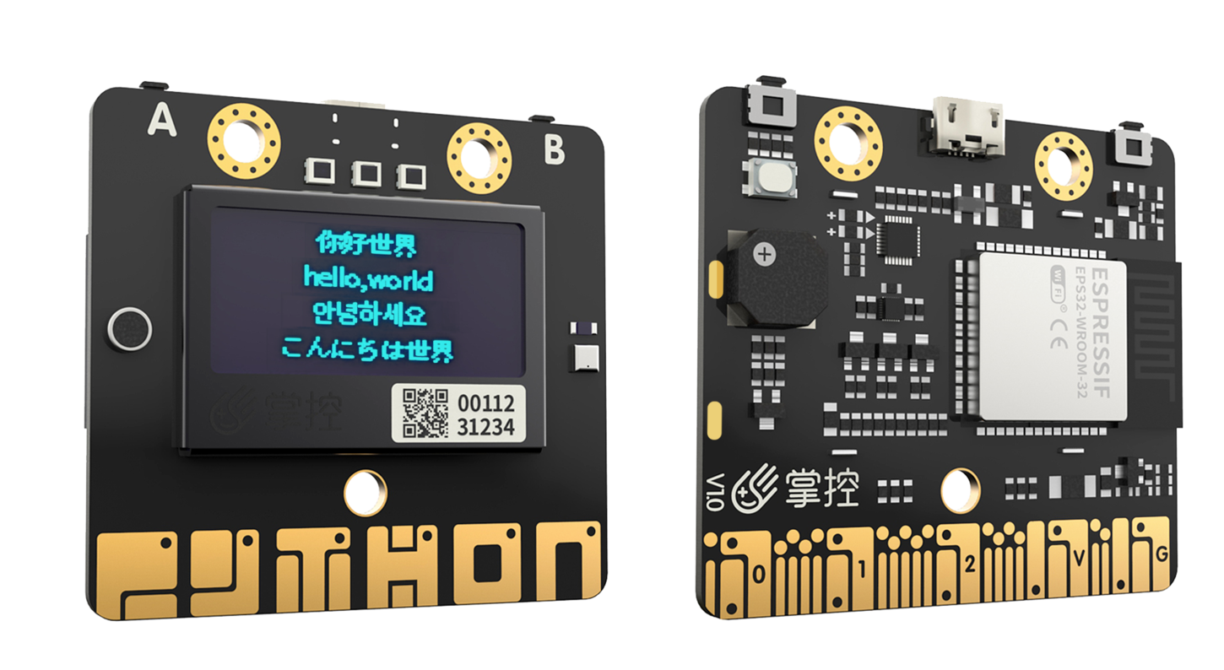
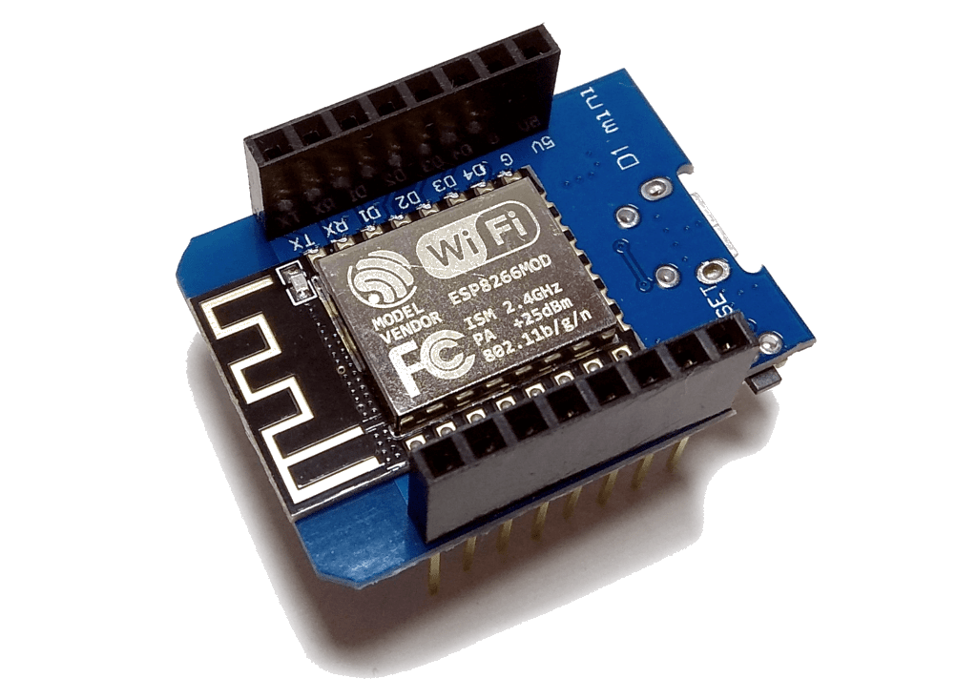
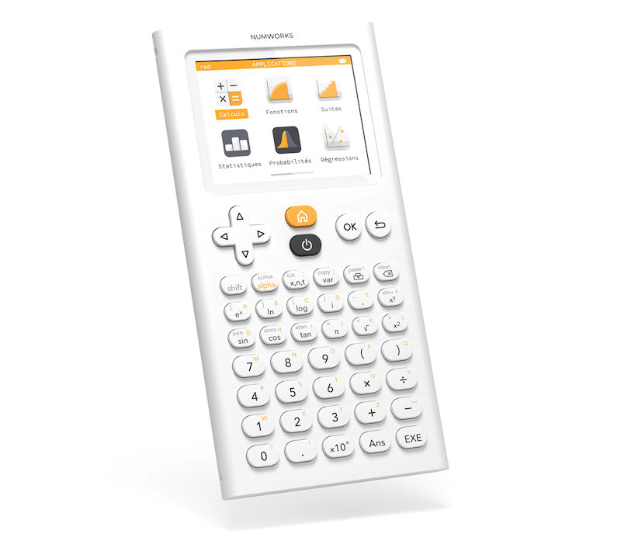
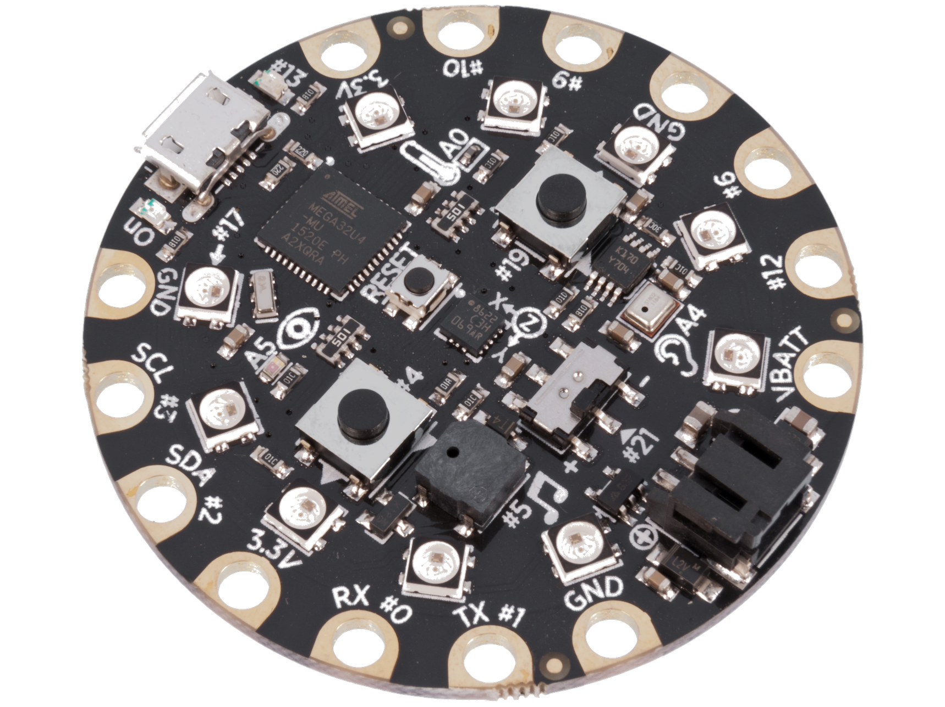
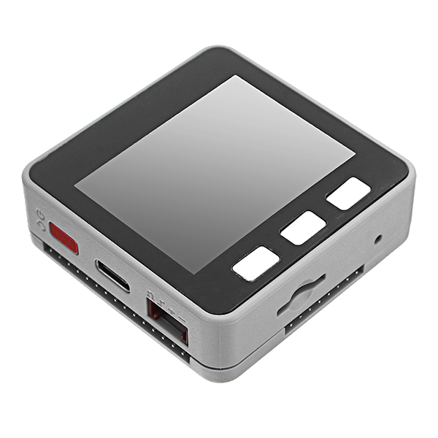
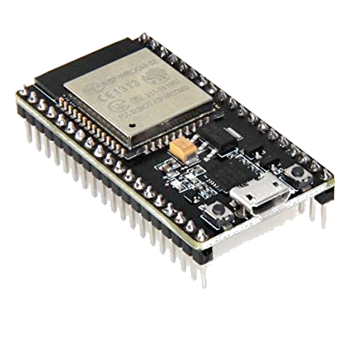
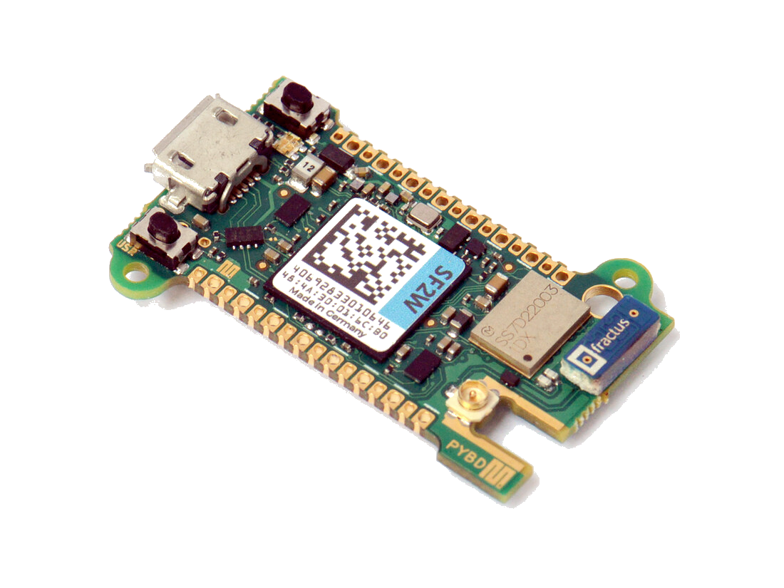
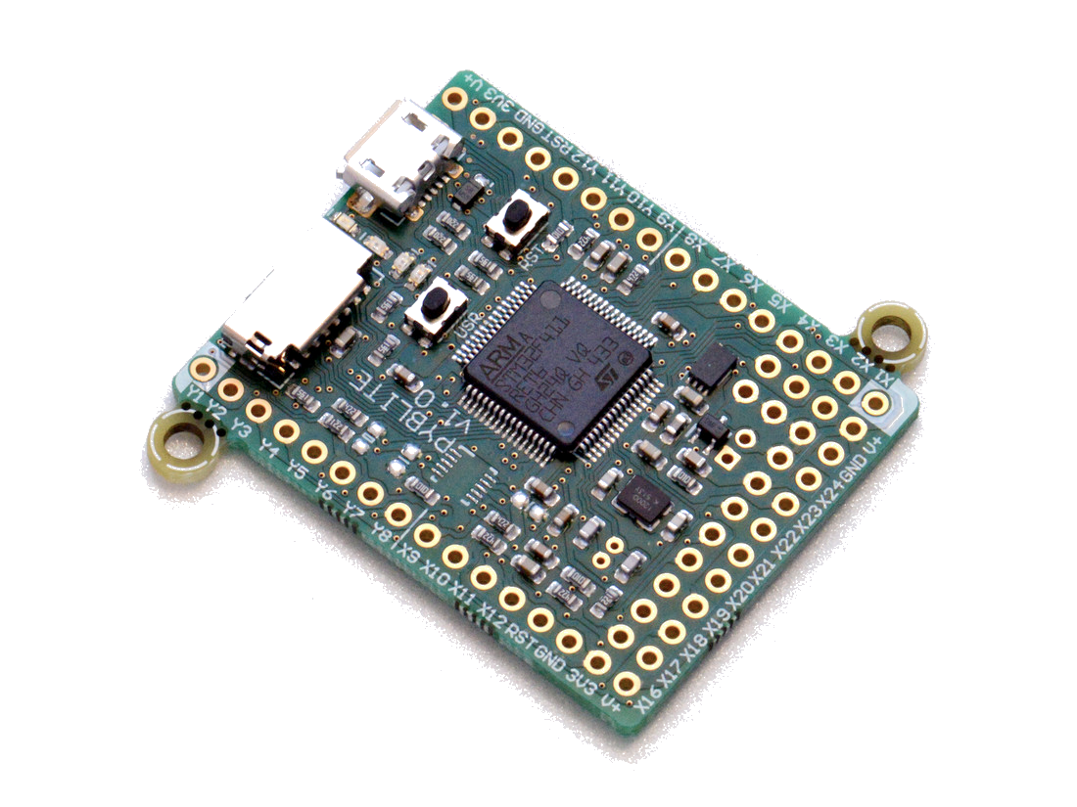
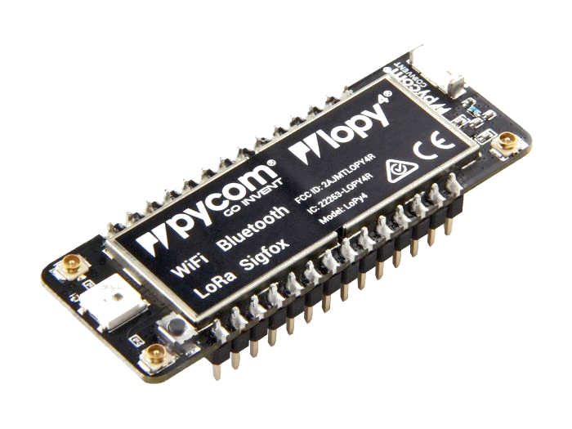
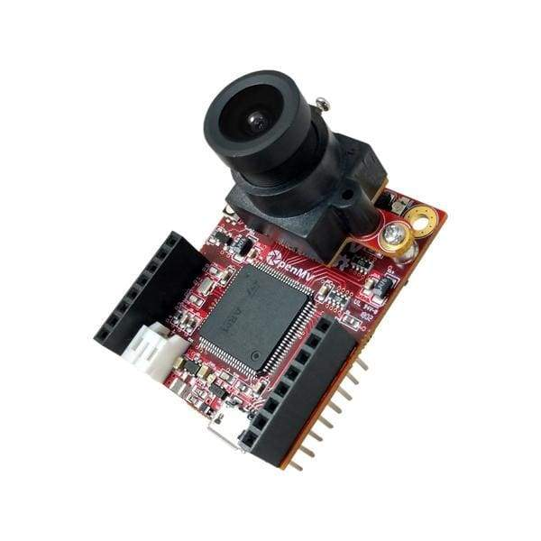
MicroPython

Slide 6
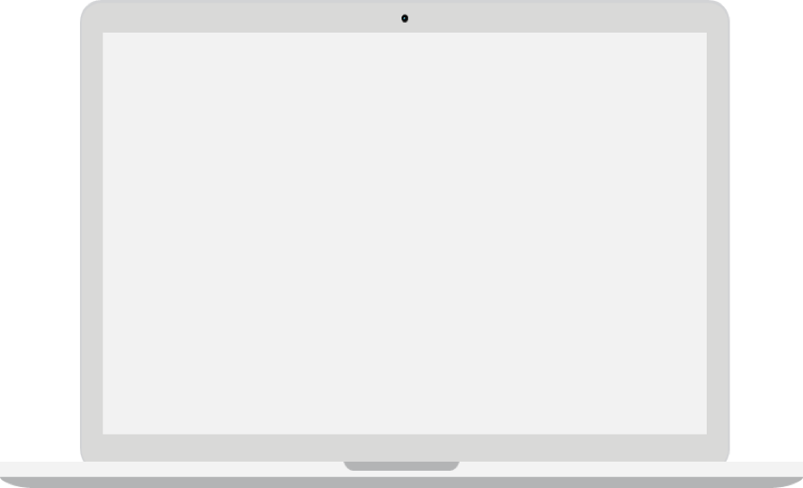
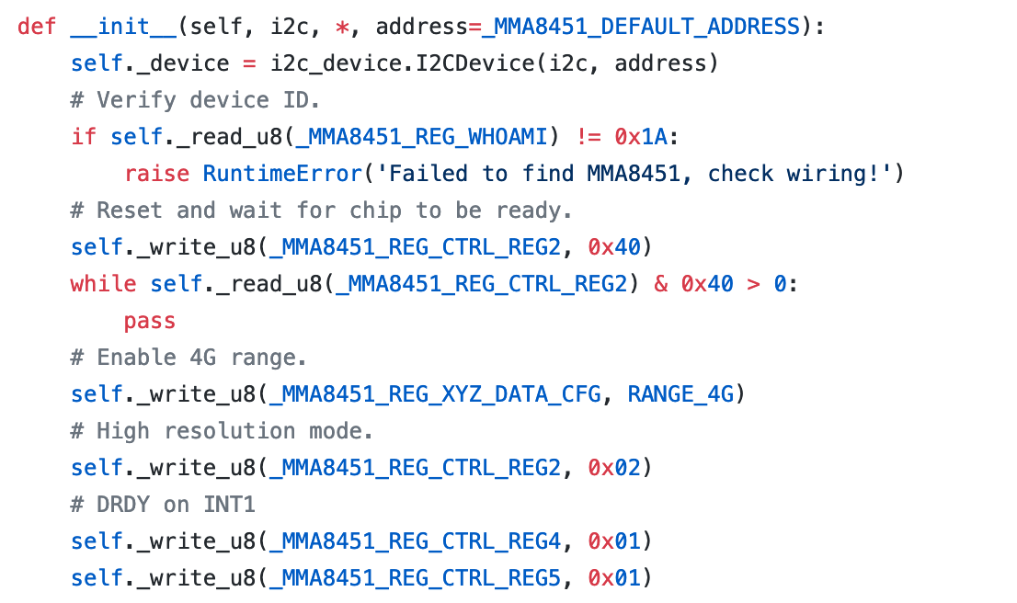
Finding A Driver
Google is your friend
GitHub is your best friend
Use implementations in other languages as reference
Look for the official documentation
Product page might contain additional documentation
Google search part number
Datasheets often found in random pages
Look for the newest version
Adafruit CircuitPython mma8451 driver https://github.com/adafruit/Adafruit_CircuitPython_MMA8451/

Slide 7
How Does Code Move Electrons

Slide 8
The Software Stack
Software
Python code
Py Modules
MicroPython
Hardware Abstraction Layer
Hardware
Microcontroller
ADC
CAN
RTC
I2S
DAC
Ethernet
USB
SDIO
SPI
I2C
PDM
PWM

Slide 9
The Software-Hardware Stack
Software
Python code
Py Modules
MicroPython
Hardware Abstraction Layer
Hardware
Microcontroller
Analog sensor
ADC
CAN
RTC
I2S
Audio Chip
Speaker
DAC
Ethernet
USB
SDIO
SD Card
Sensor
SPI
I2C
PDM
PWM
Servo
Sensor
Sensor
Sensor
Microphone

Slide 10
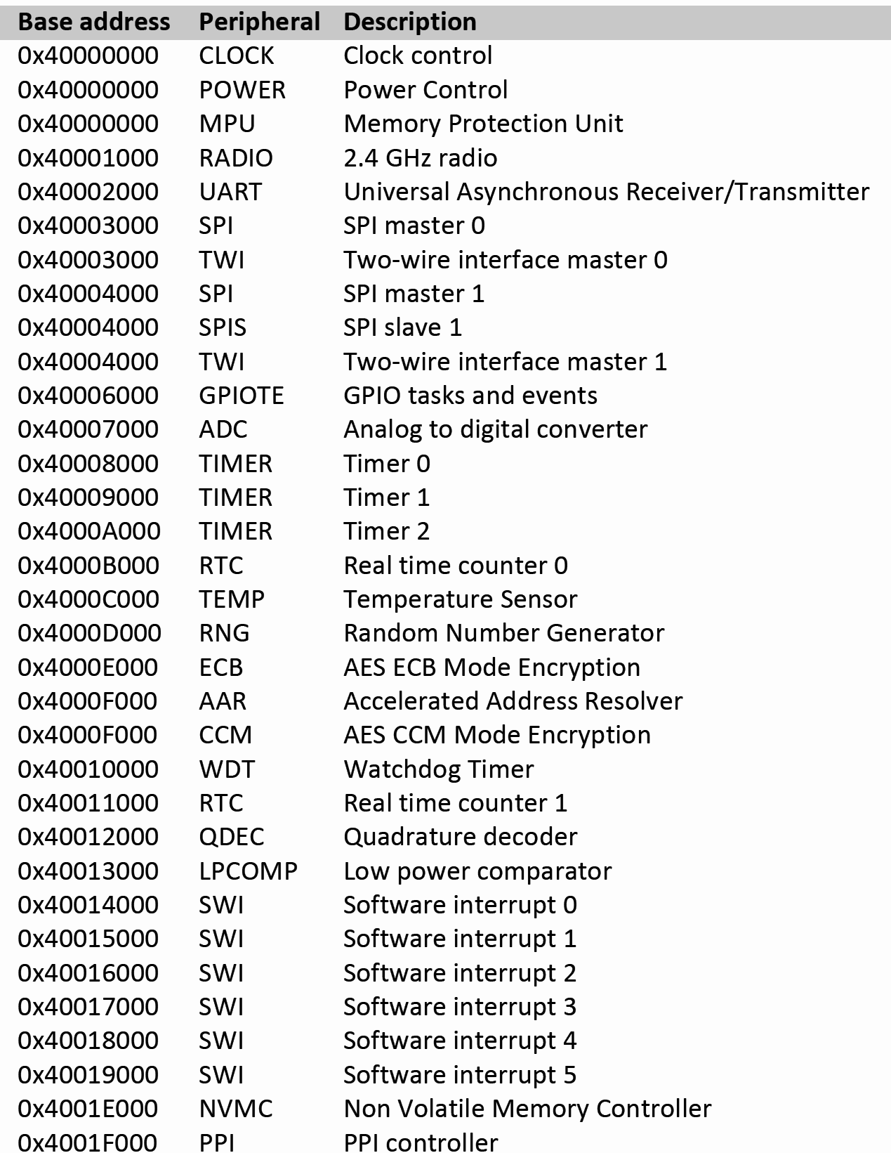
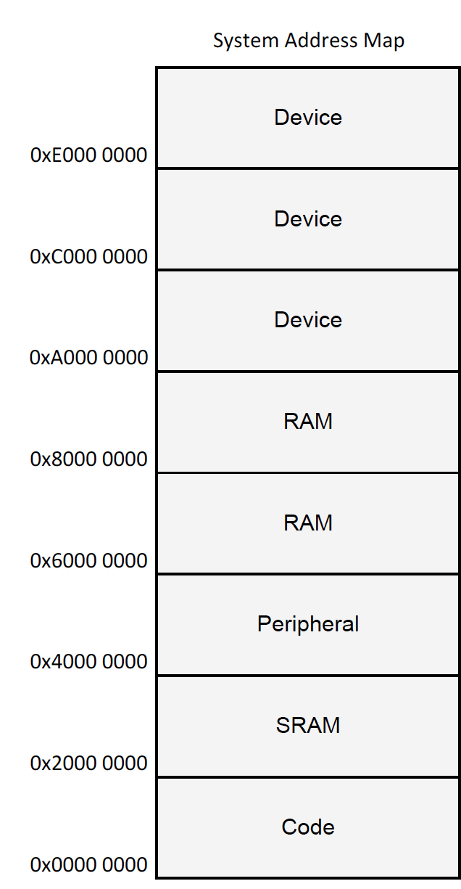
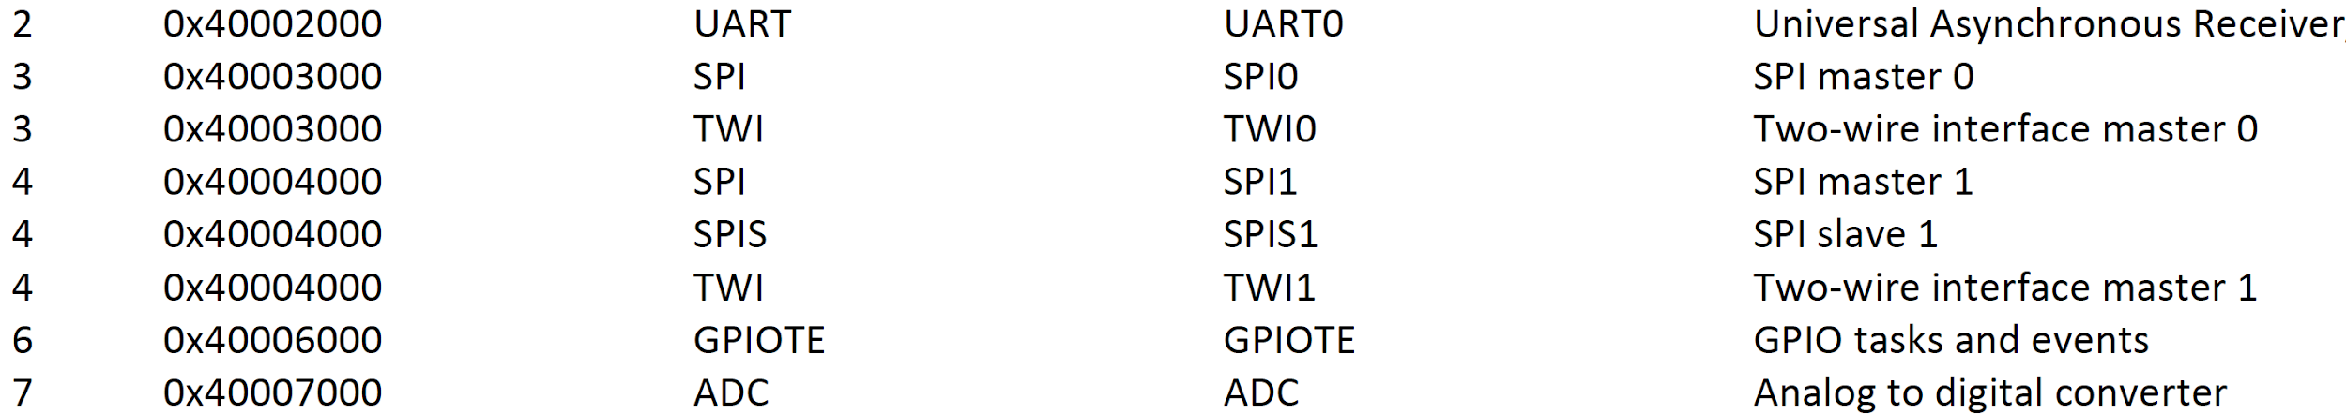
Memory Map And Peripherals

Slide 11
Memory Map And Peripherals

Slide 12
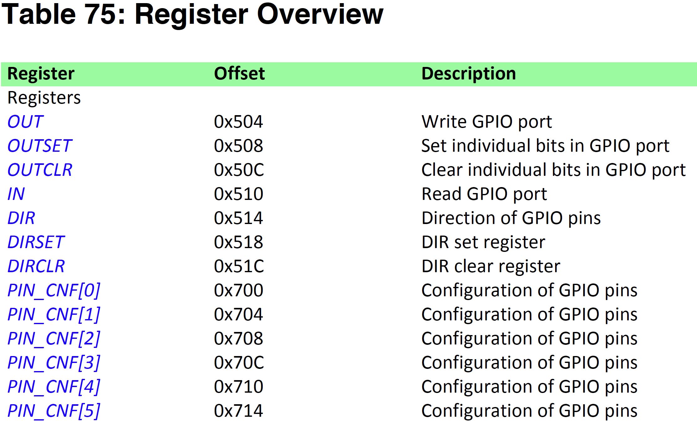
Registers

Slide 13
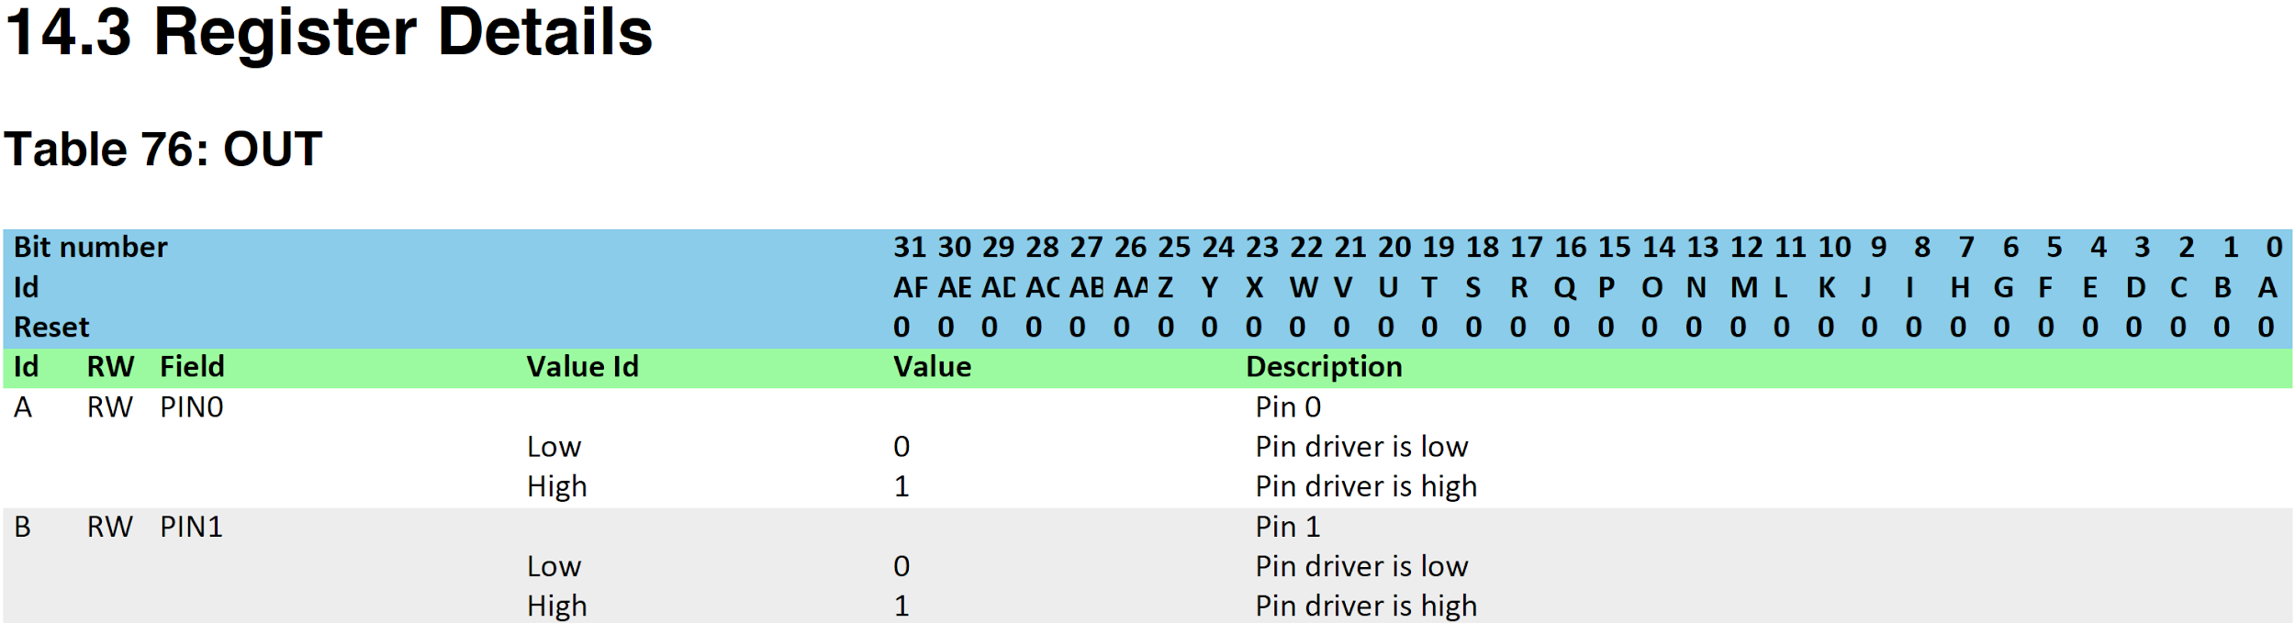
Registers

Slide 14

Registers

Slide 15
Registers

Slide 16
Talking With Other Electronic Devices

Slide 17
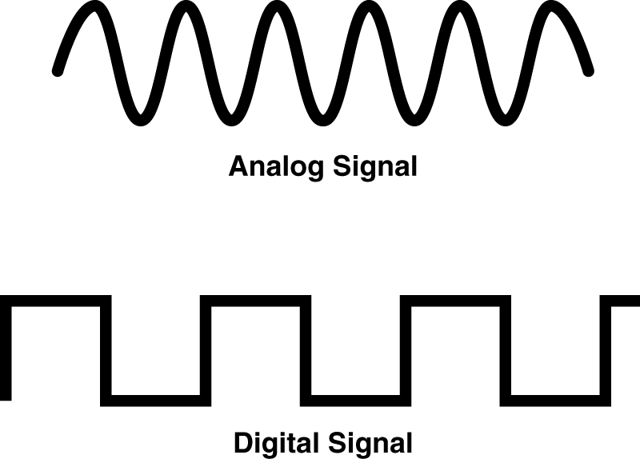
Talking With Electronic Devices
Some devices use analog signals as inputs or outputs
Analog sensors encode simple data in the voltage magnitude
Optic fibre modulates data using multiple techniques
Most electronic components in a PCB use digital signals
Data is sent in serial/parallel communication protocols
We’ll cover the most common digital protocols

Slide 18

I²C Protocol
Inter-Integrated Circuit
Synchronous serial protocol
1 clock signal, 1 data signal
Single master, multiple slaves
Multi-master possible
All sharing the same bus
Each slave has individual address
Commonly at 100 KHz or 400 KHz
sometimes higher speeds available
SMB based on I2C
VDD
Master
SDA SCL
Slave
Slave
Slave
...

Slide 19
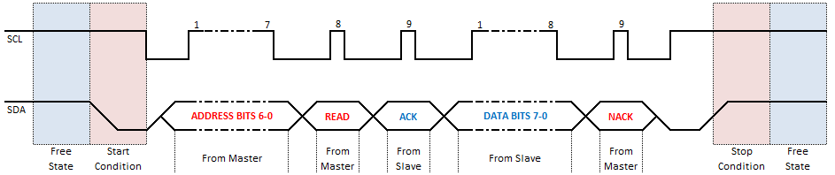
I²C Protocol
from machine import I2C
i2c = I2C(freq=400000)
data = i2c.readfrom(SLAVE_ADDRESS, HOW_MANY_BYTES)
Protocol diagram from: https://rheingoldheavy.com/i2c-signals/

Slide 20
How do we know what to send down the wire?
Datasheets!

Slide 21
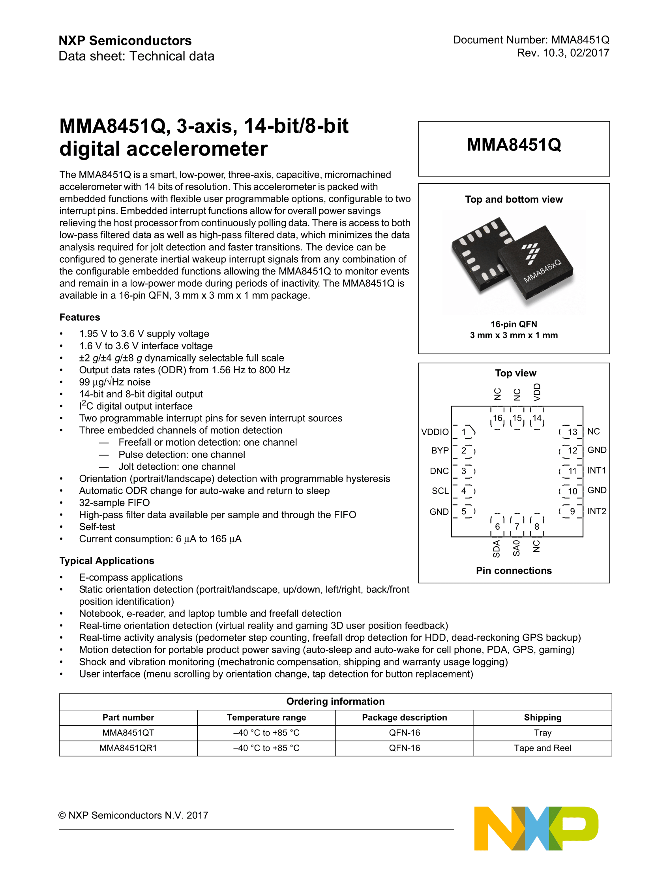
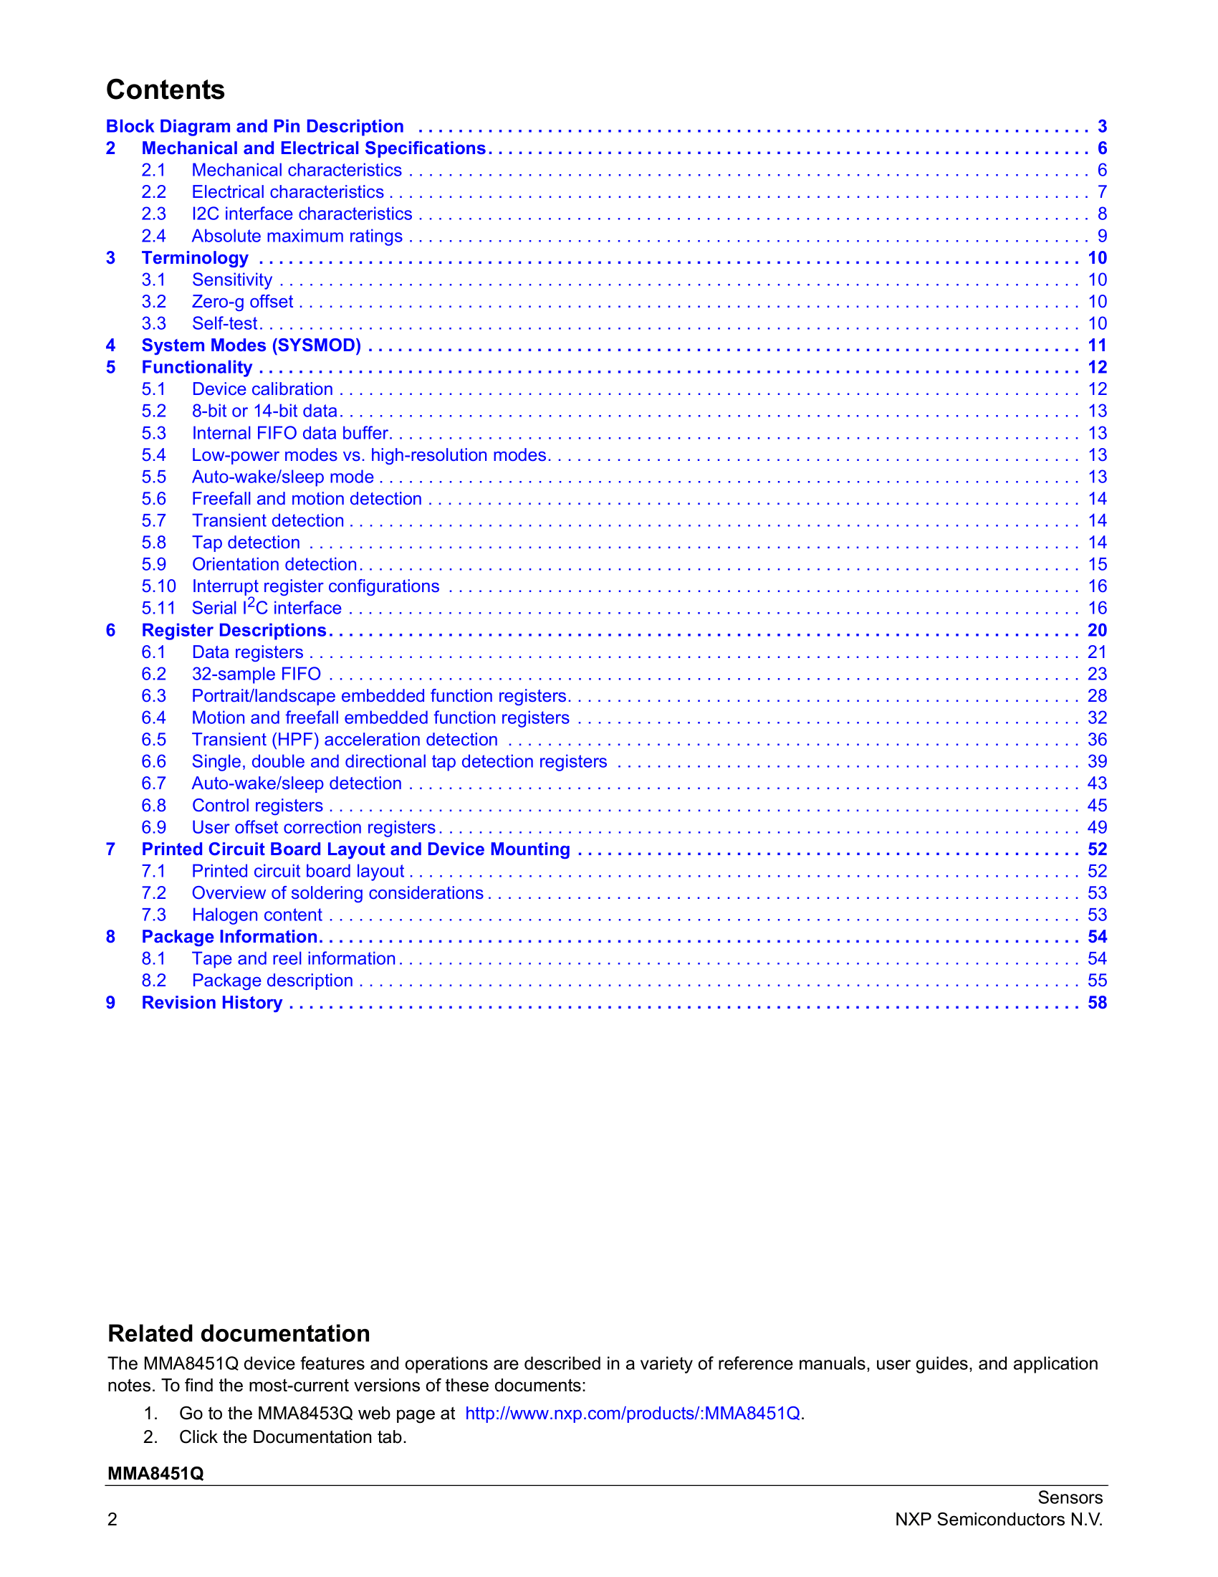
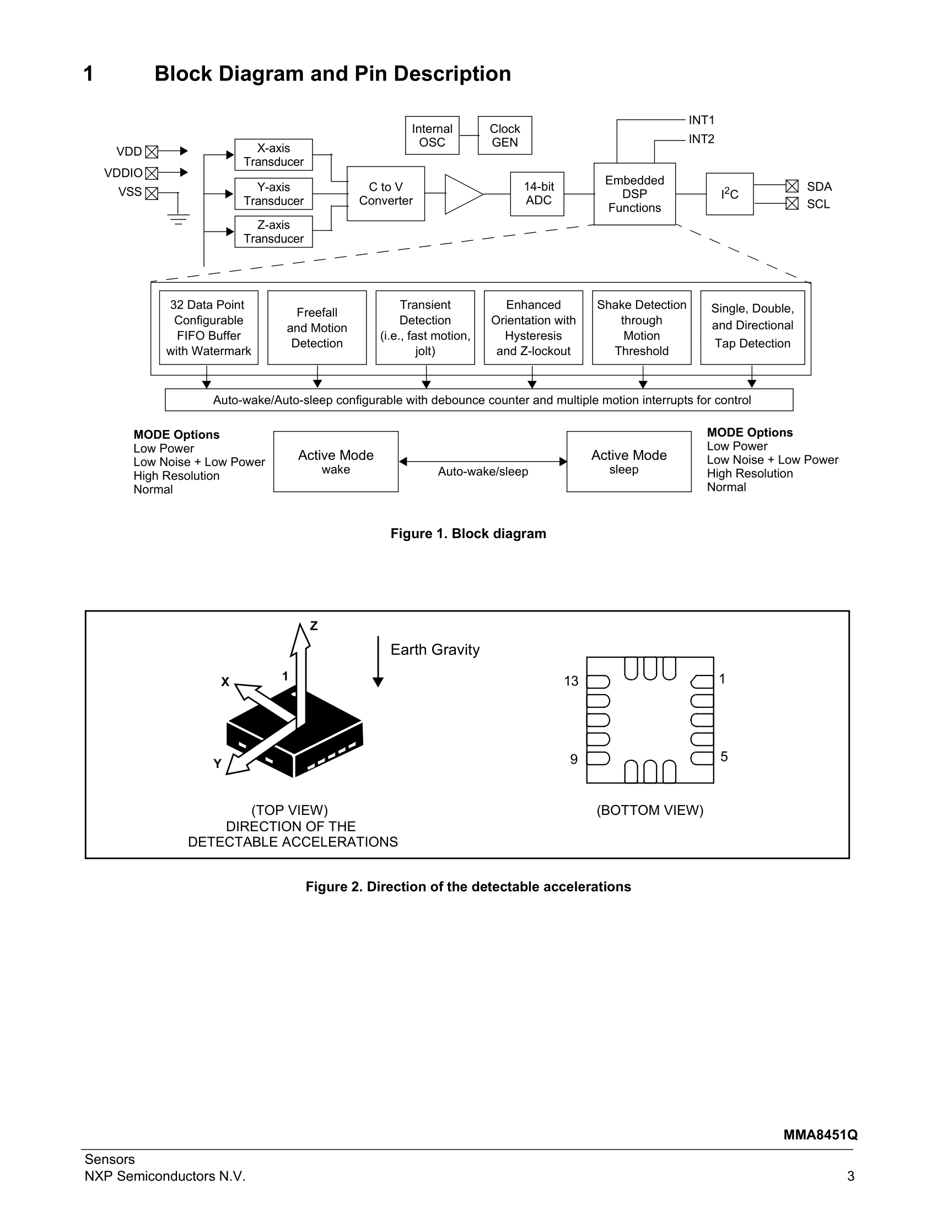
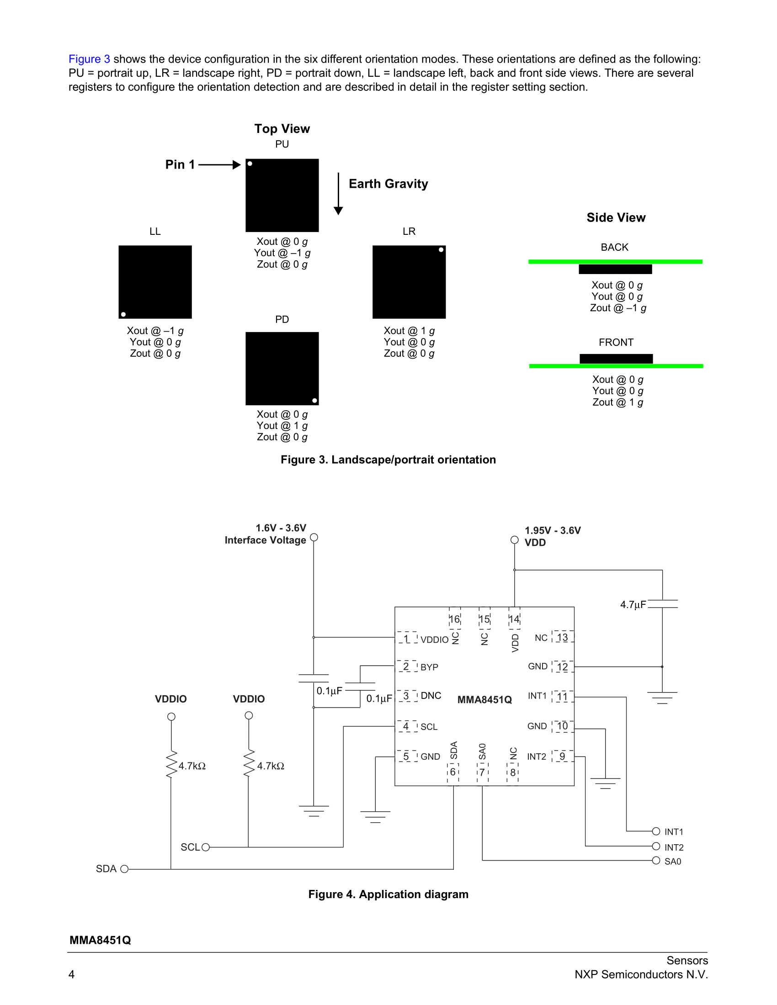
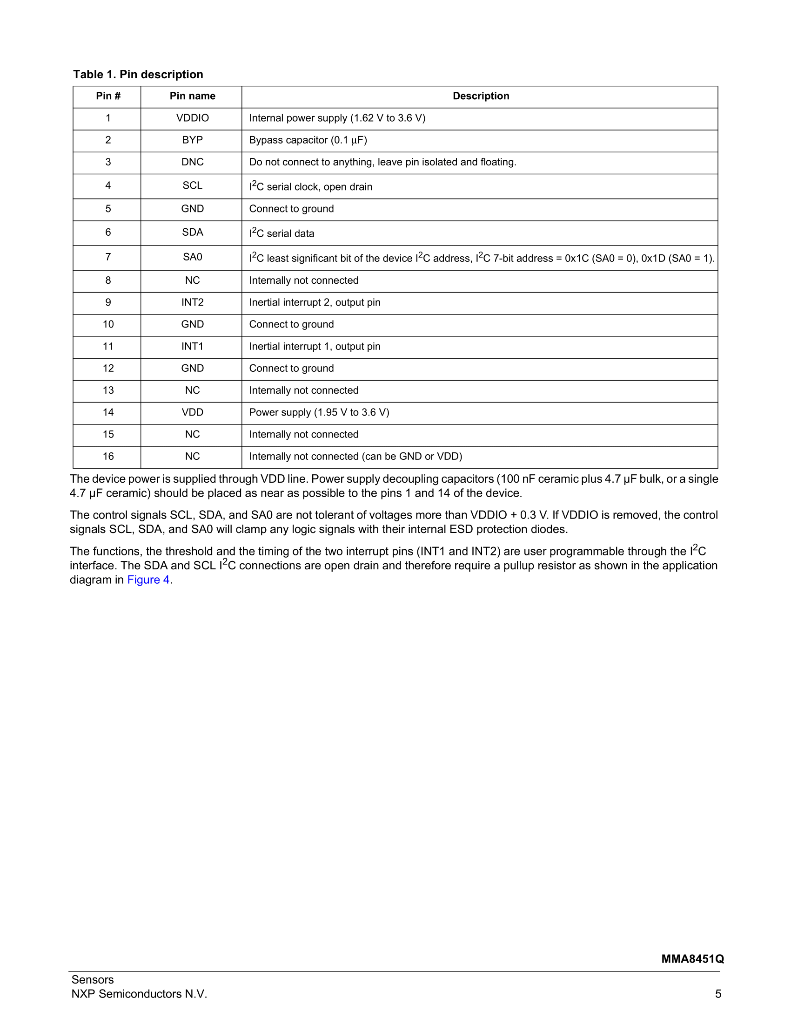
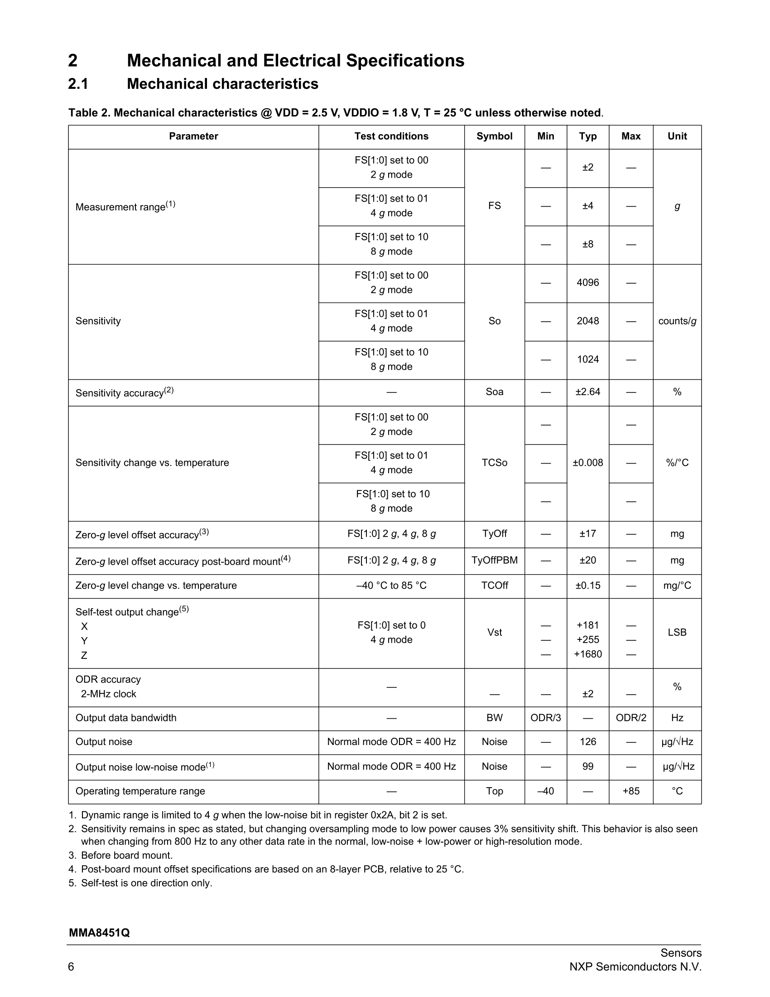
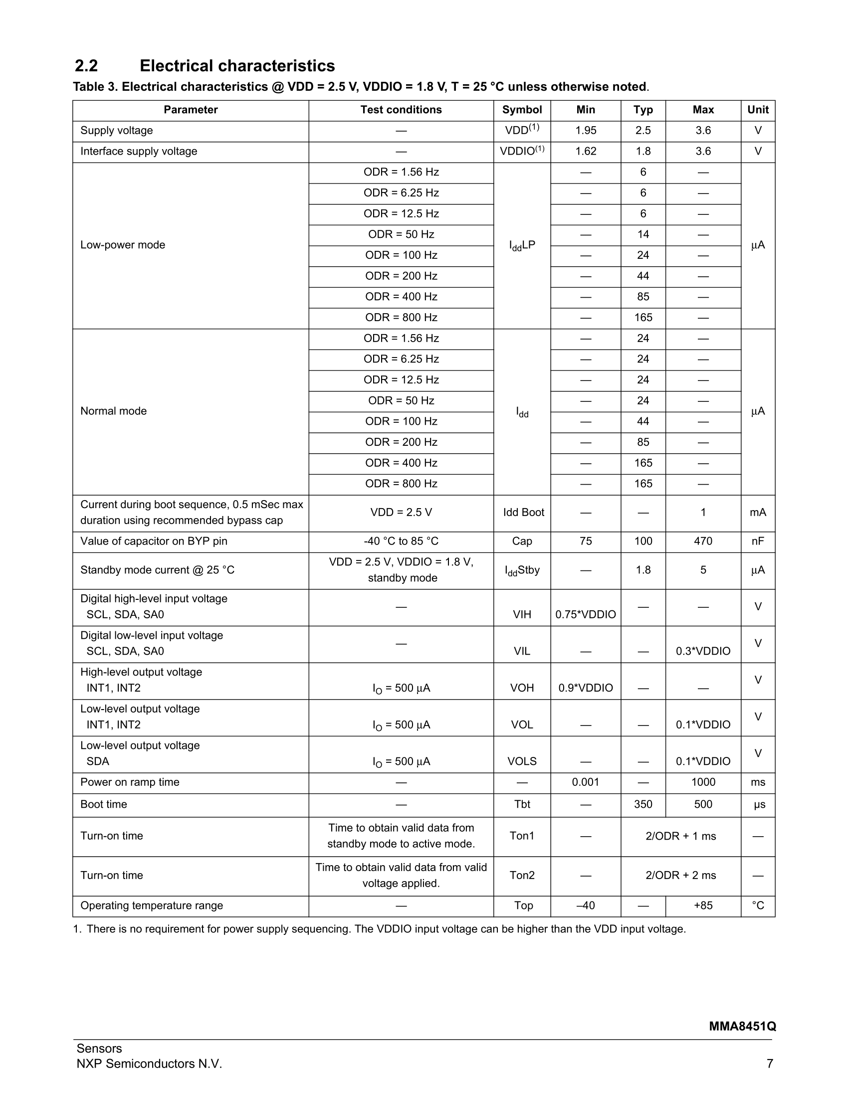
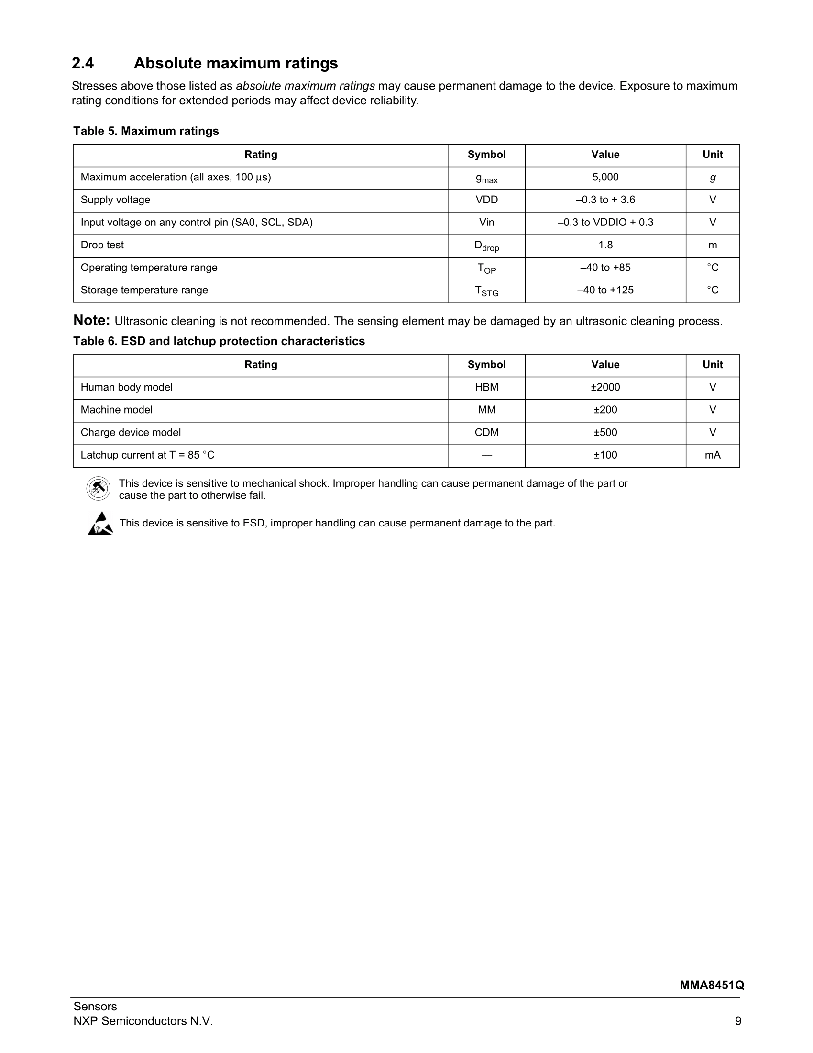
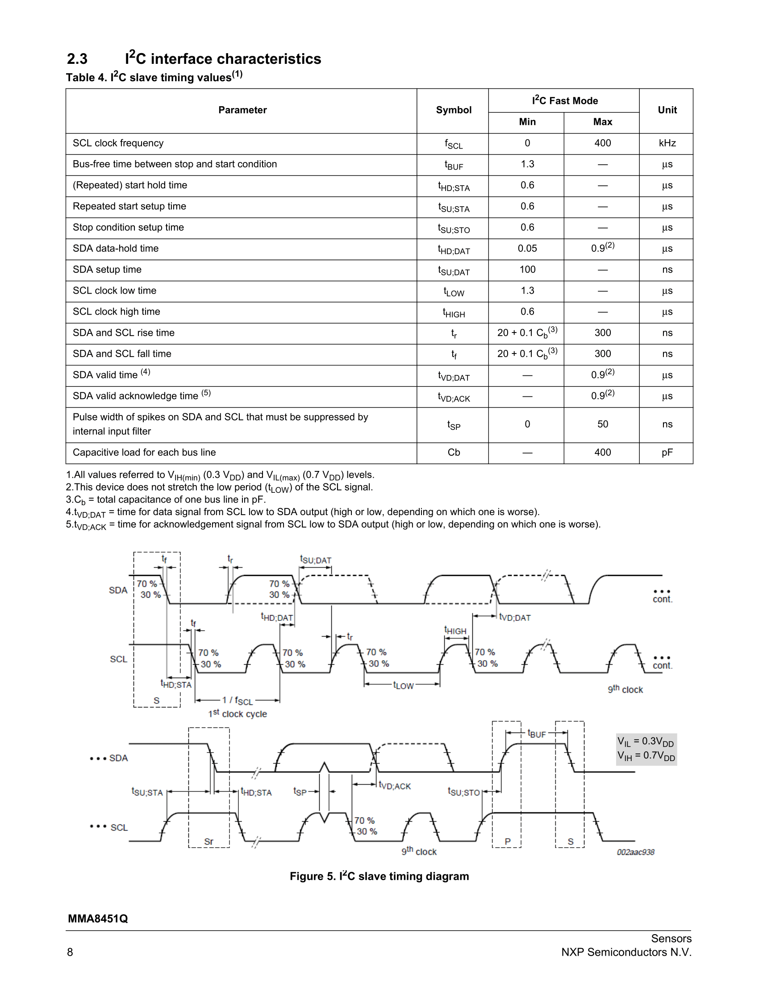

Slide 22
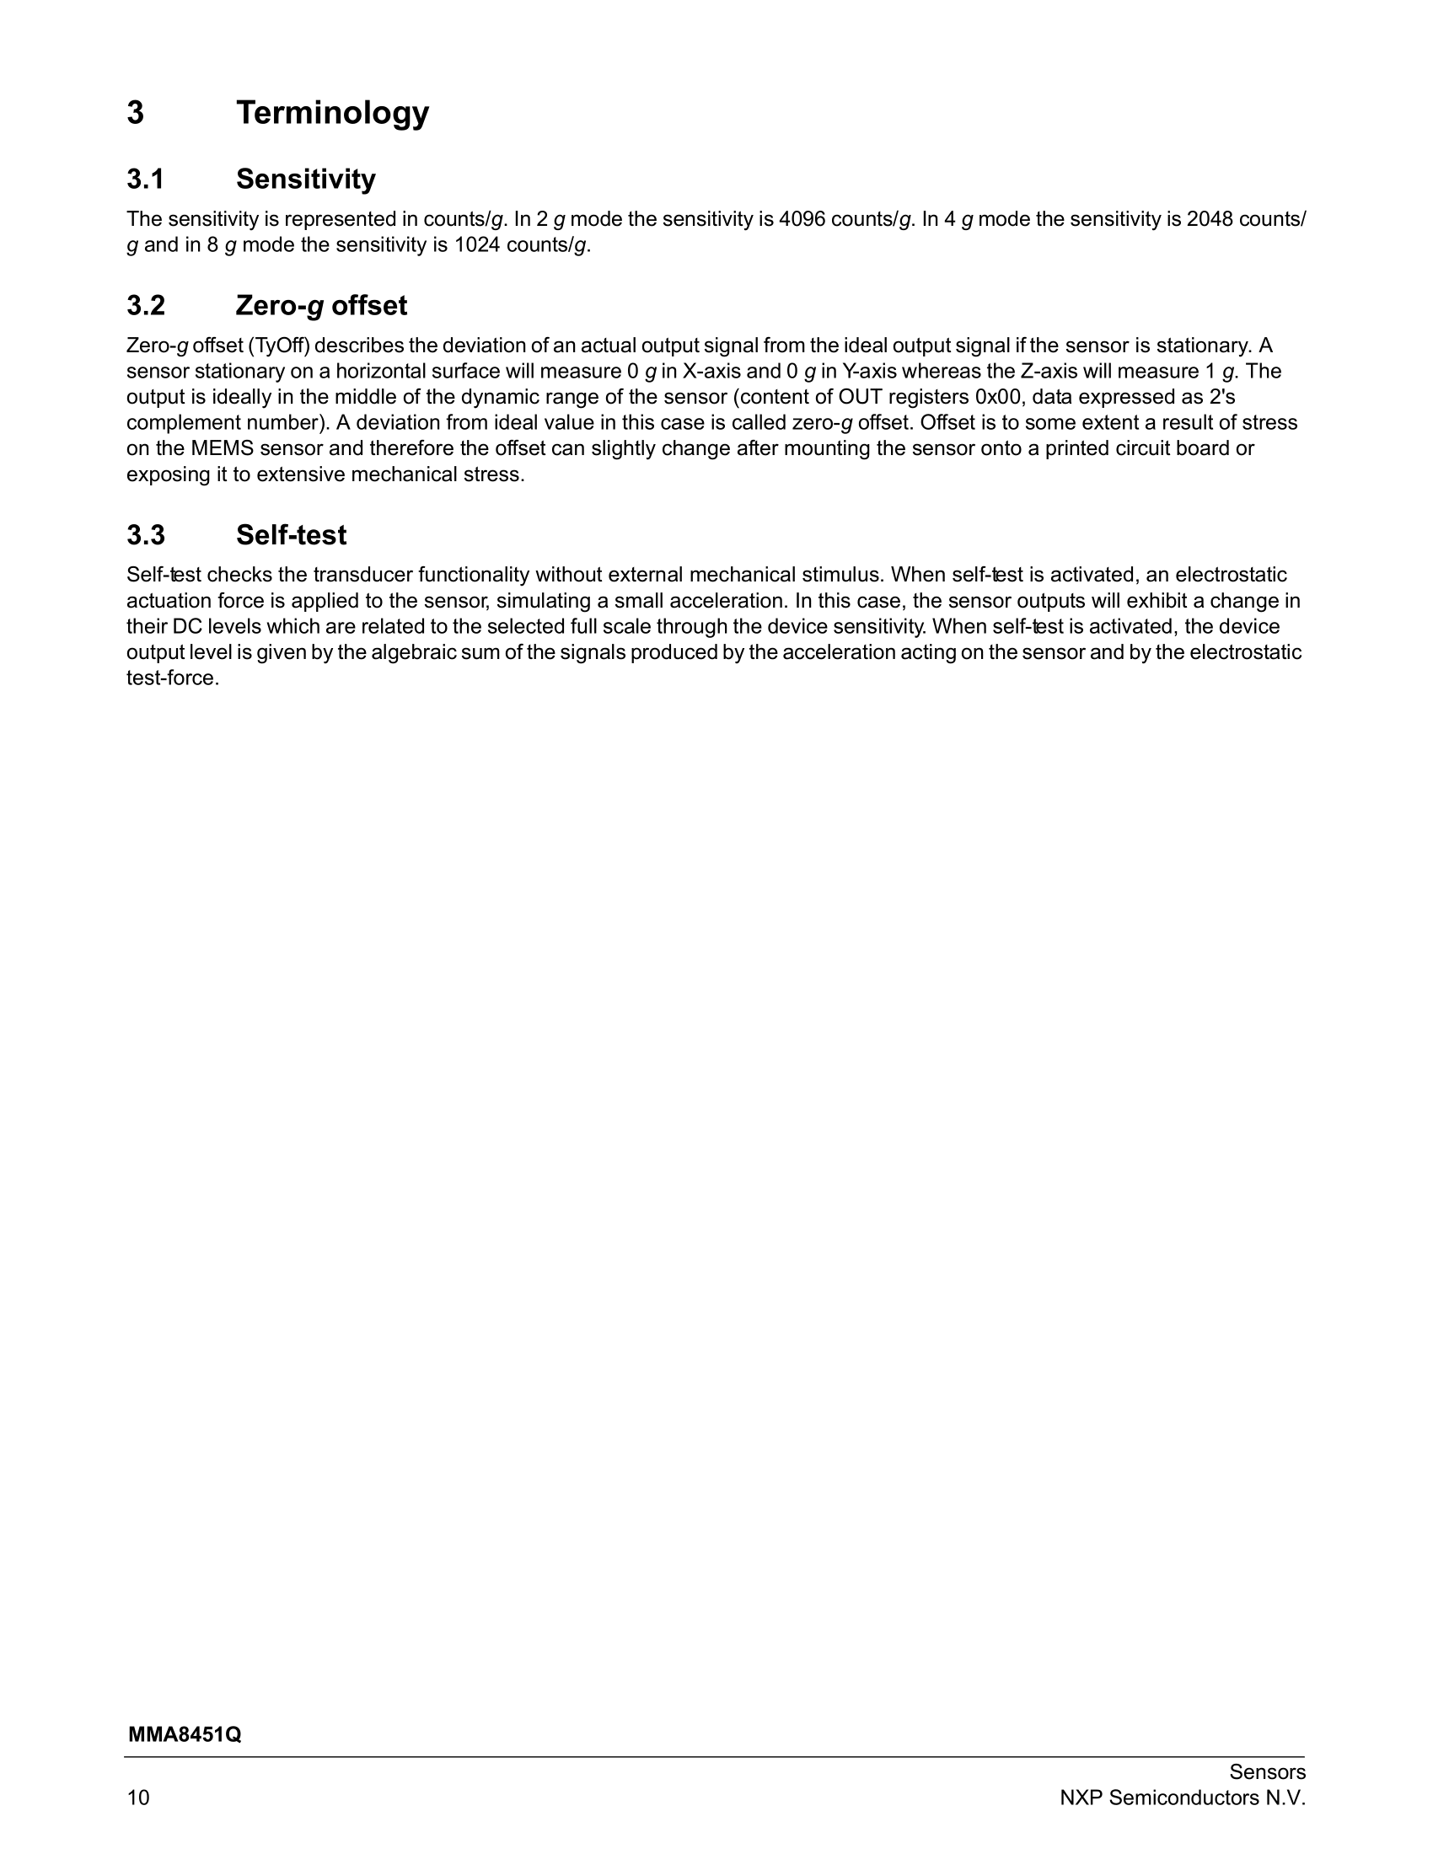
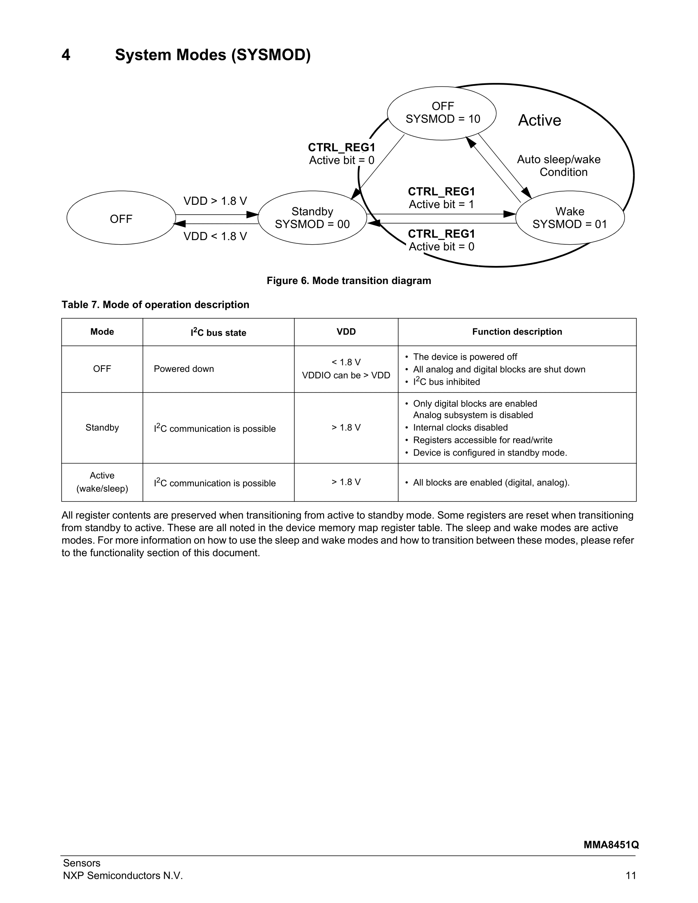
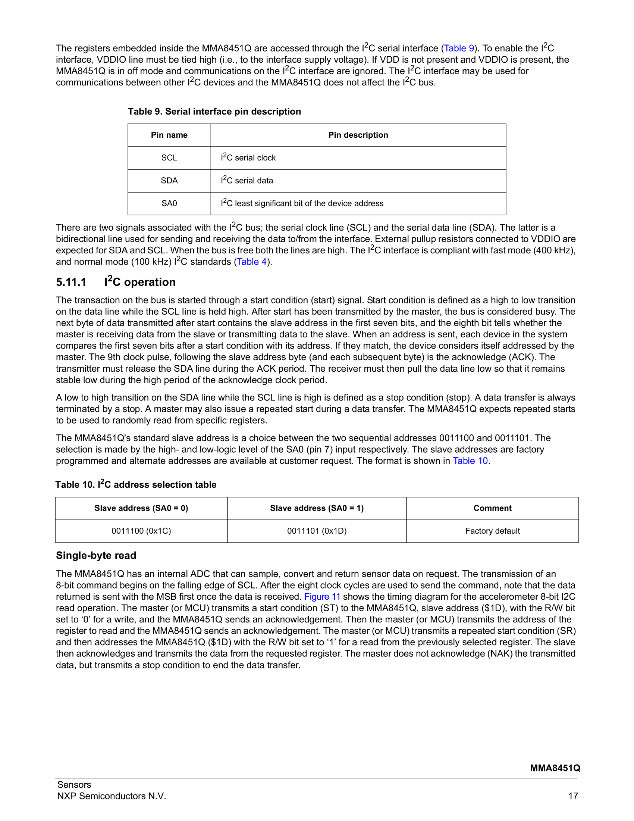
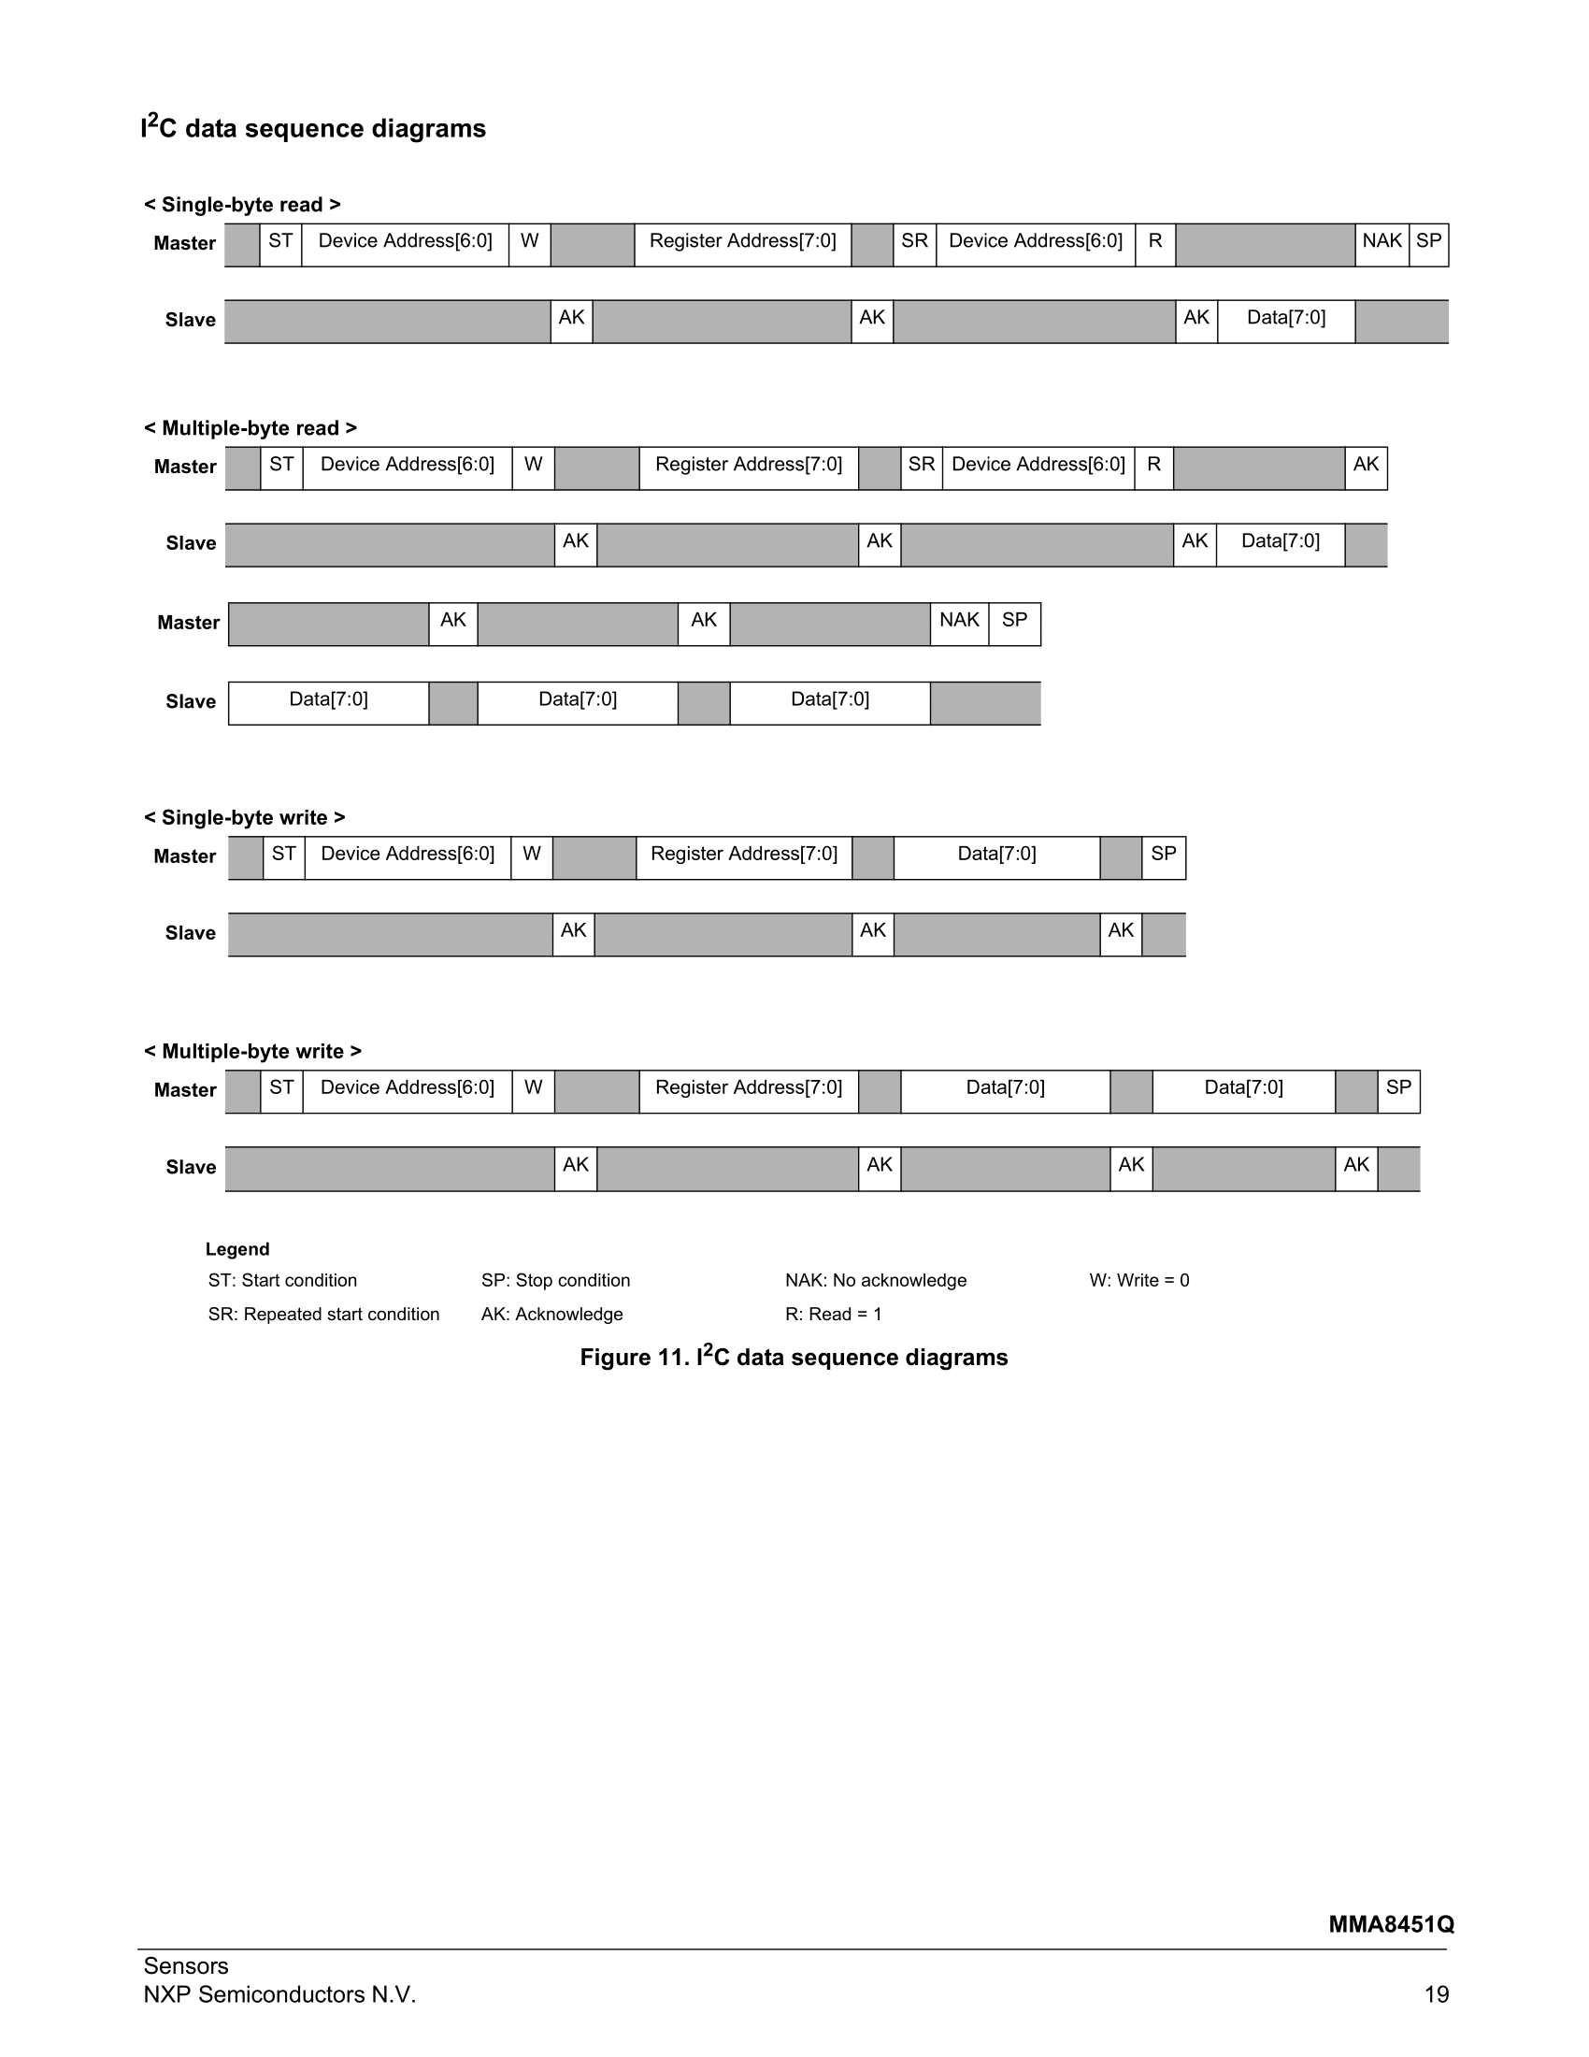
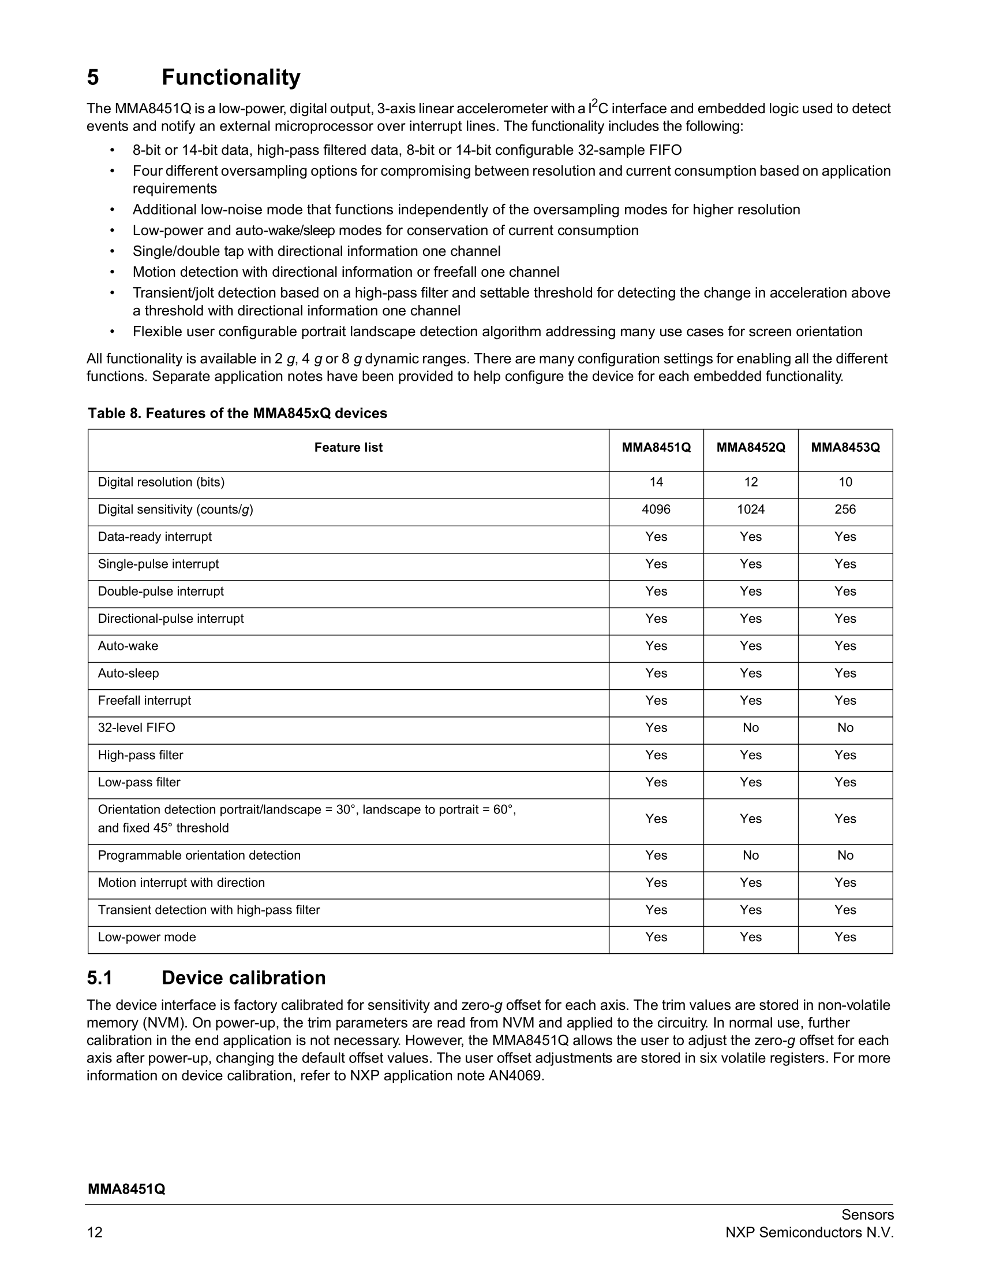
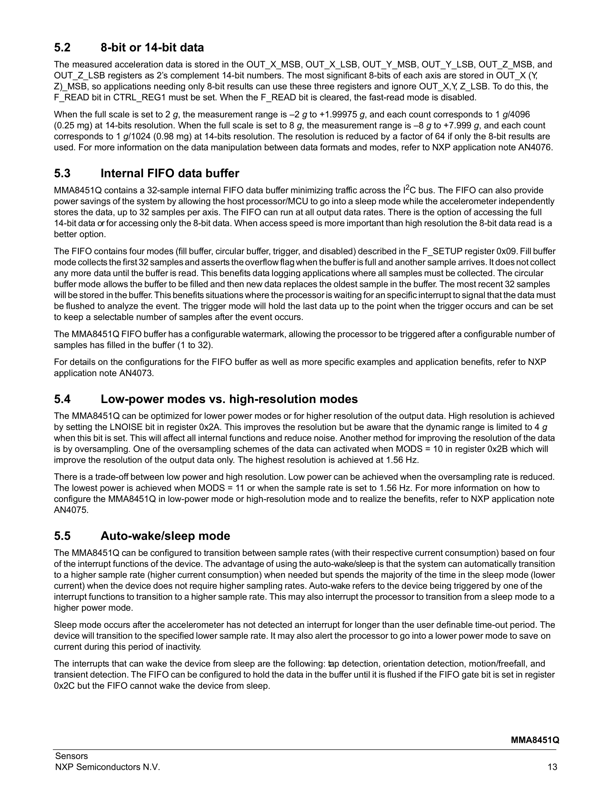
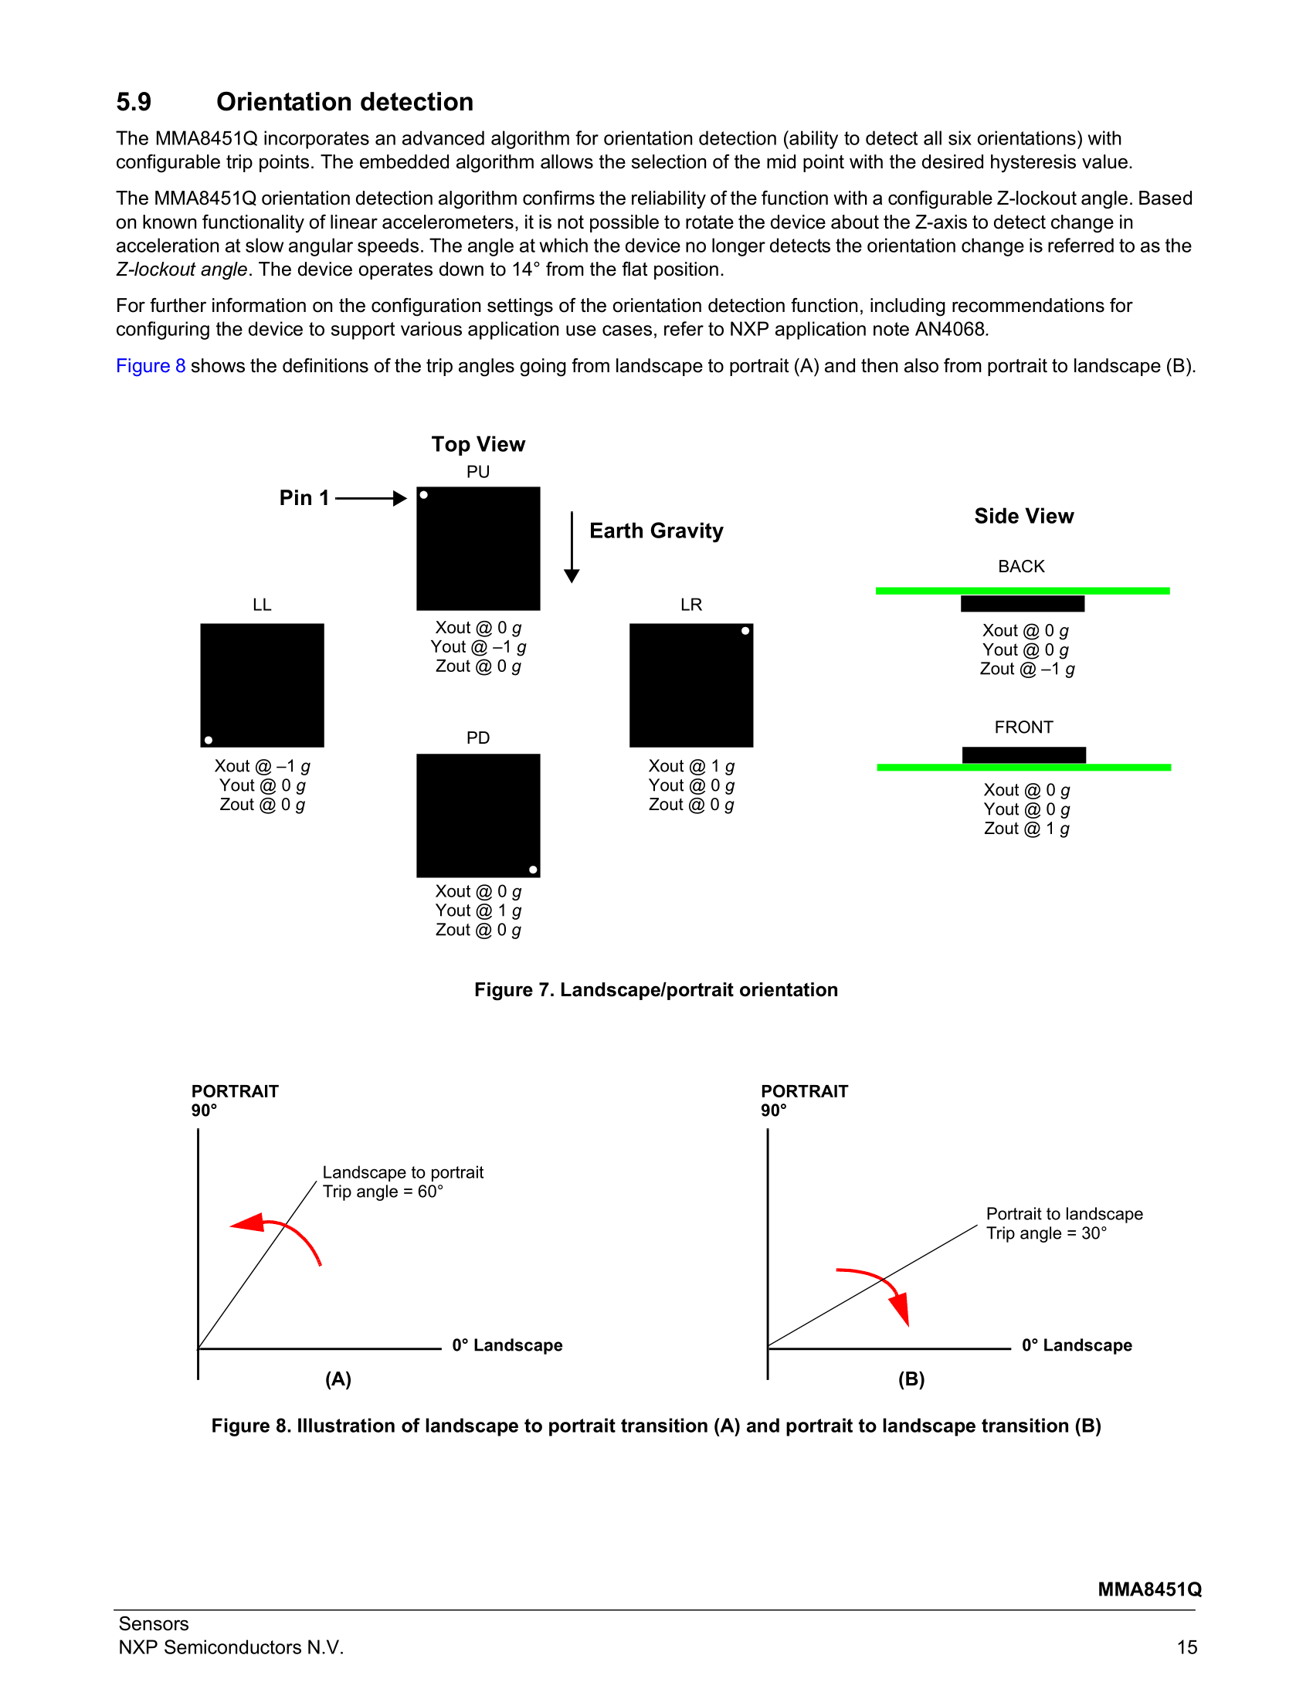
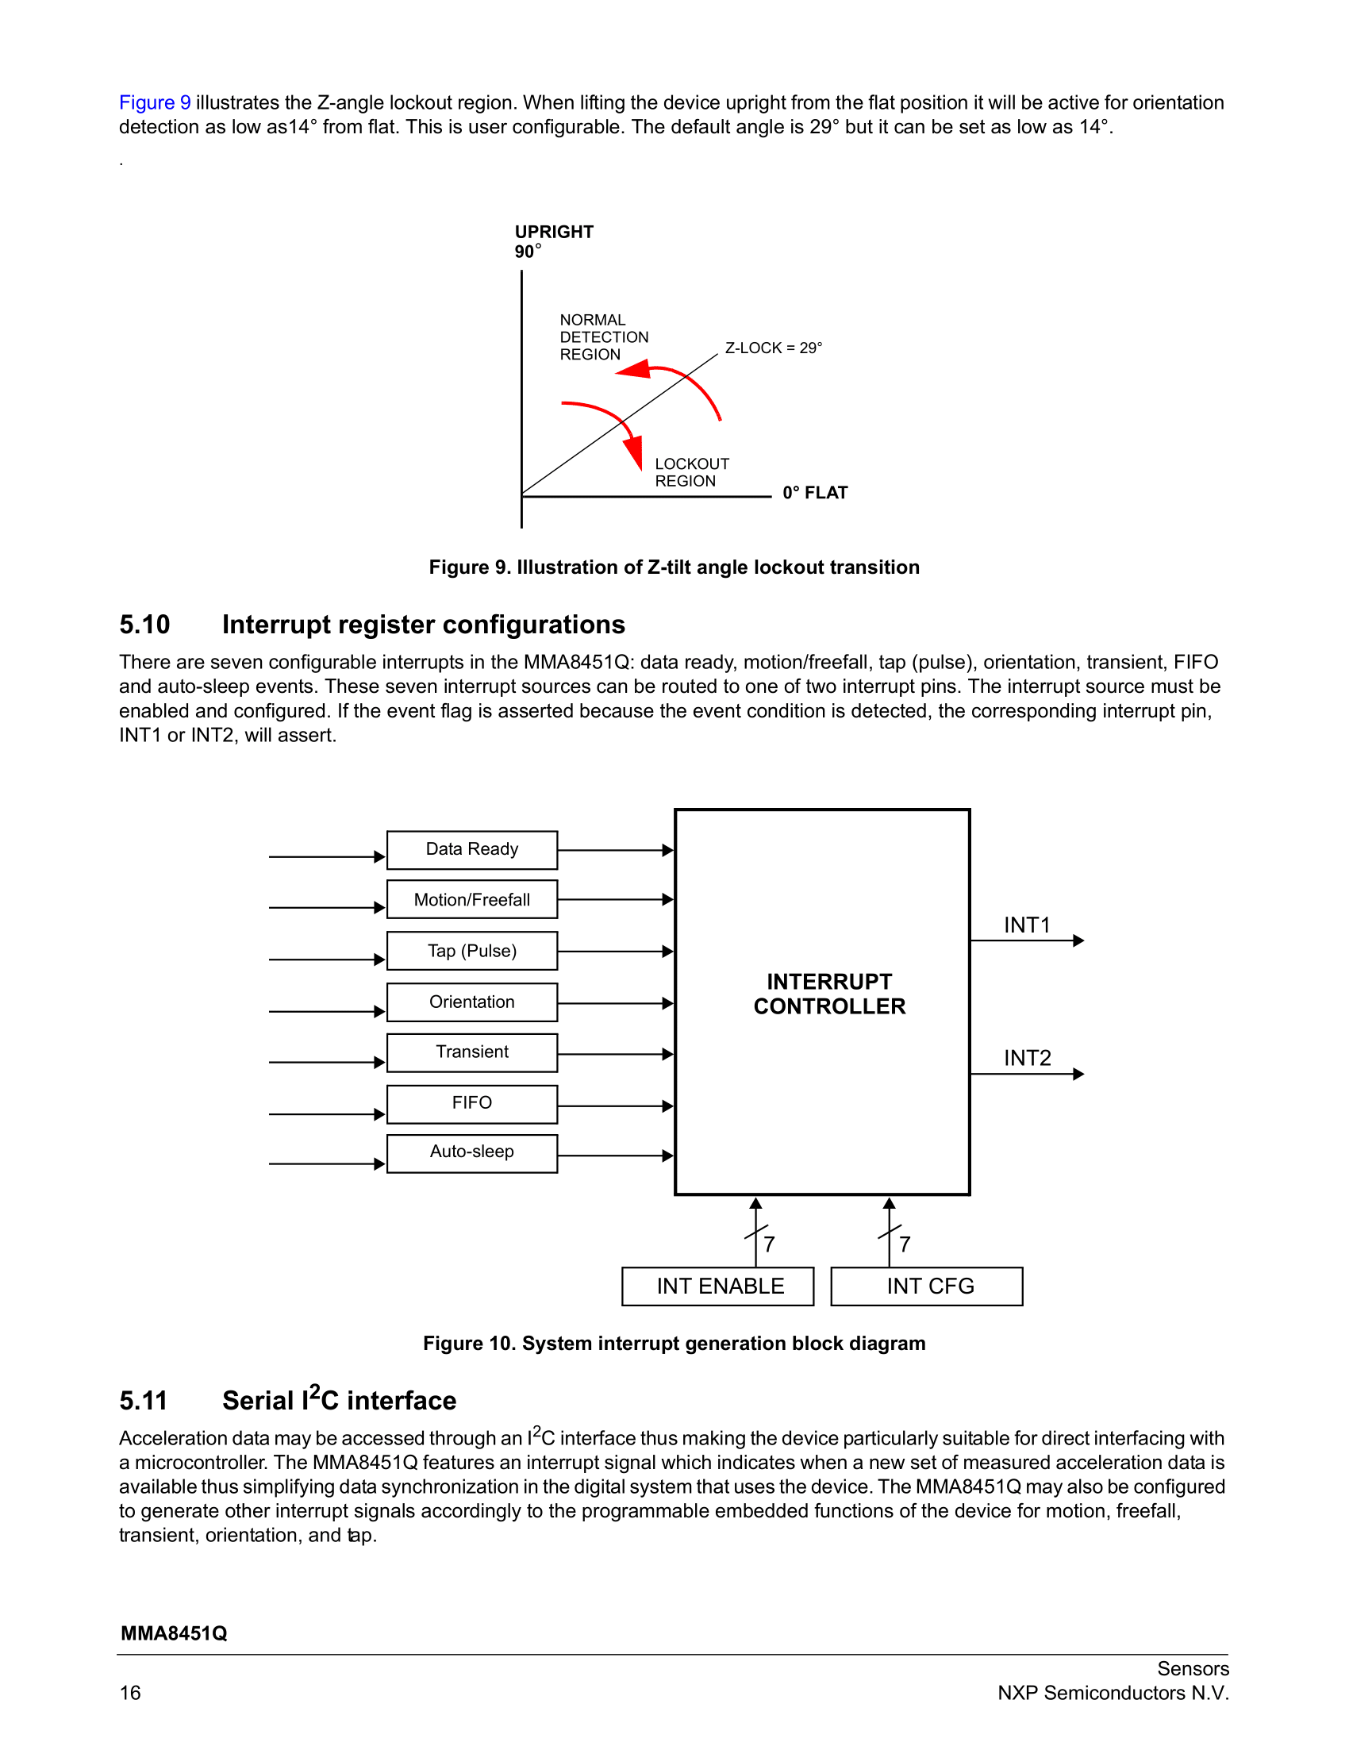
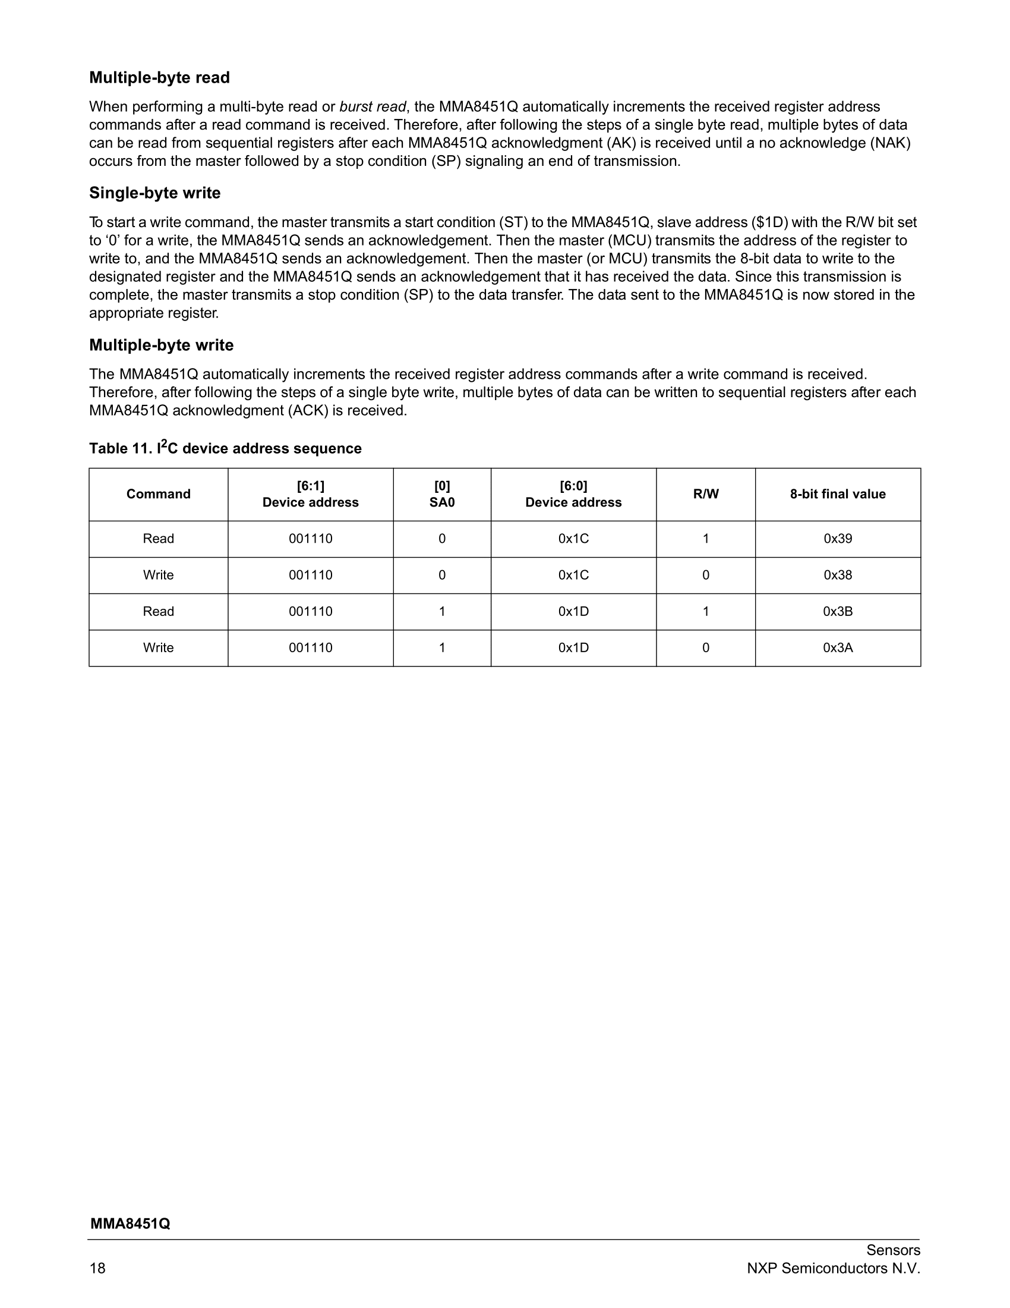
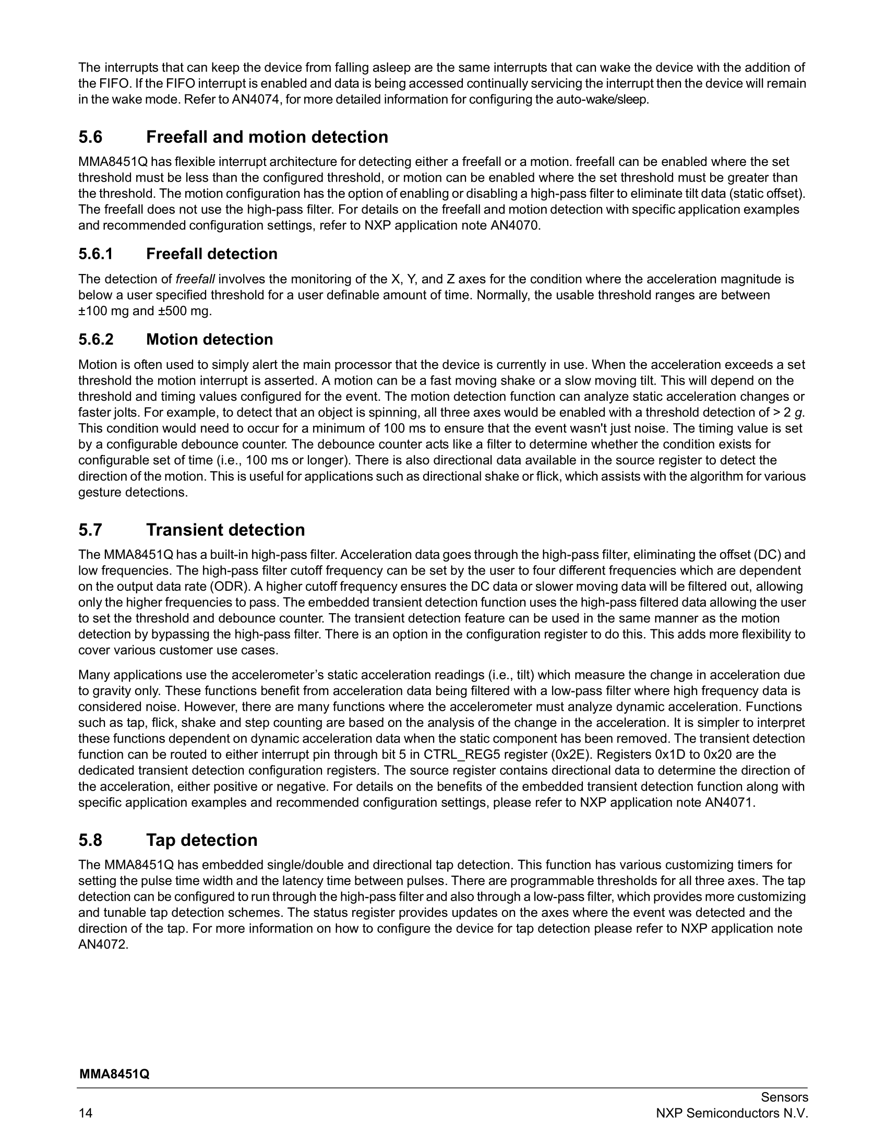

Slide 23
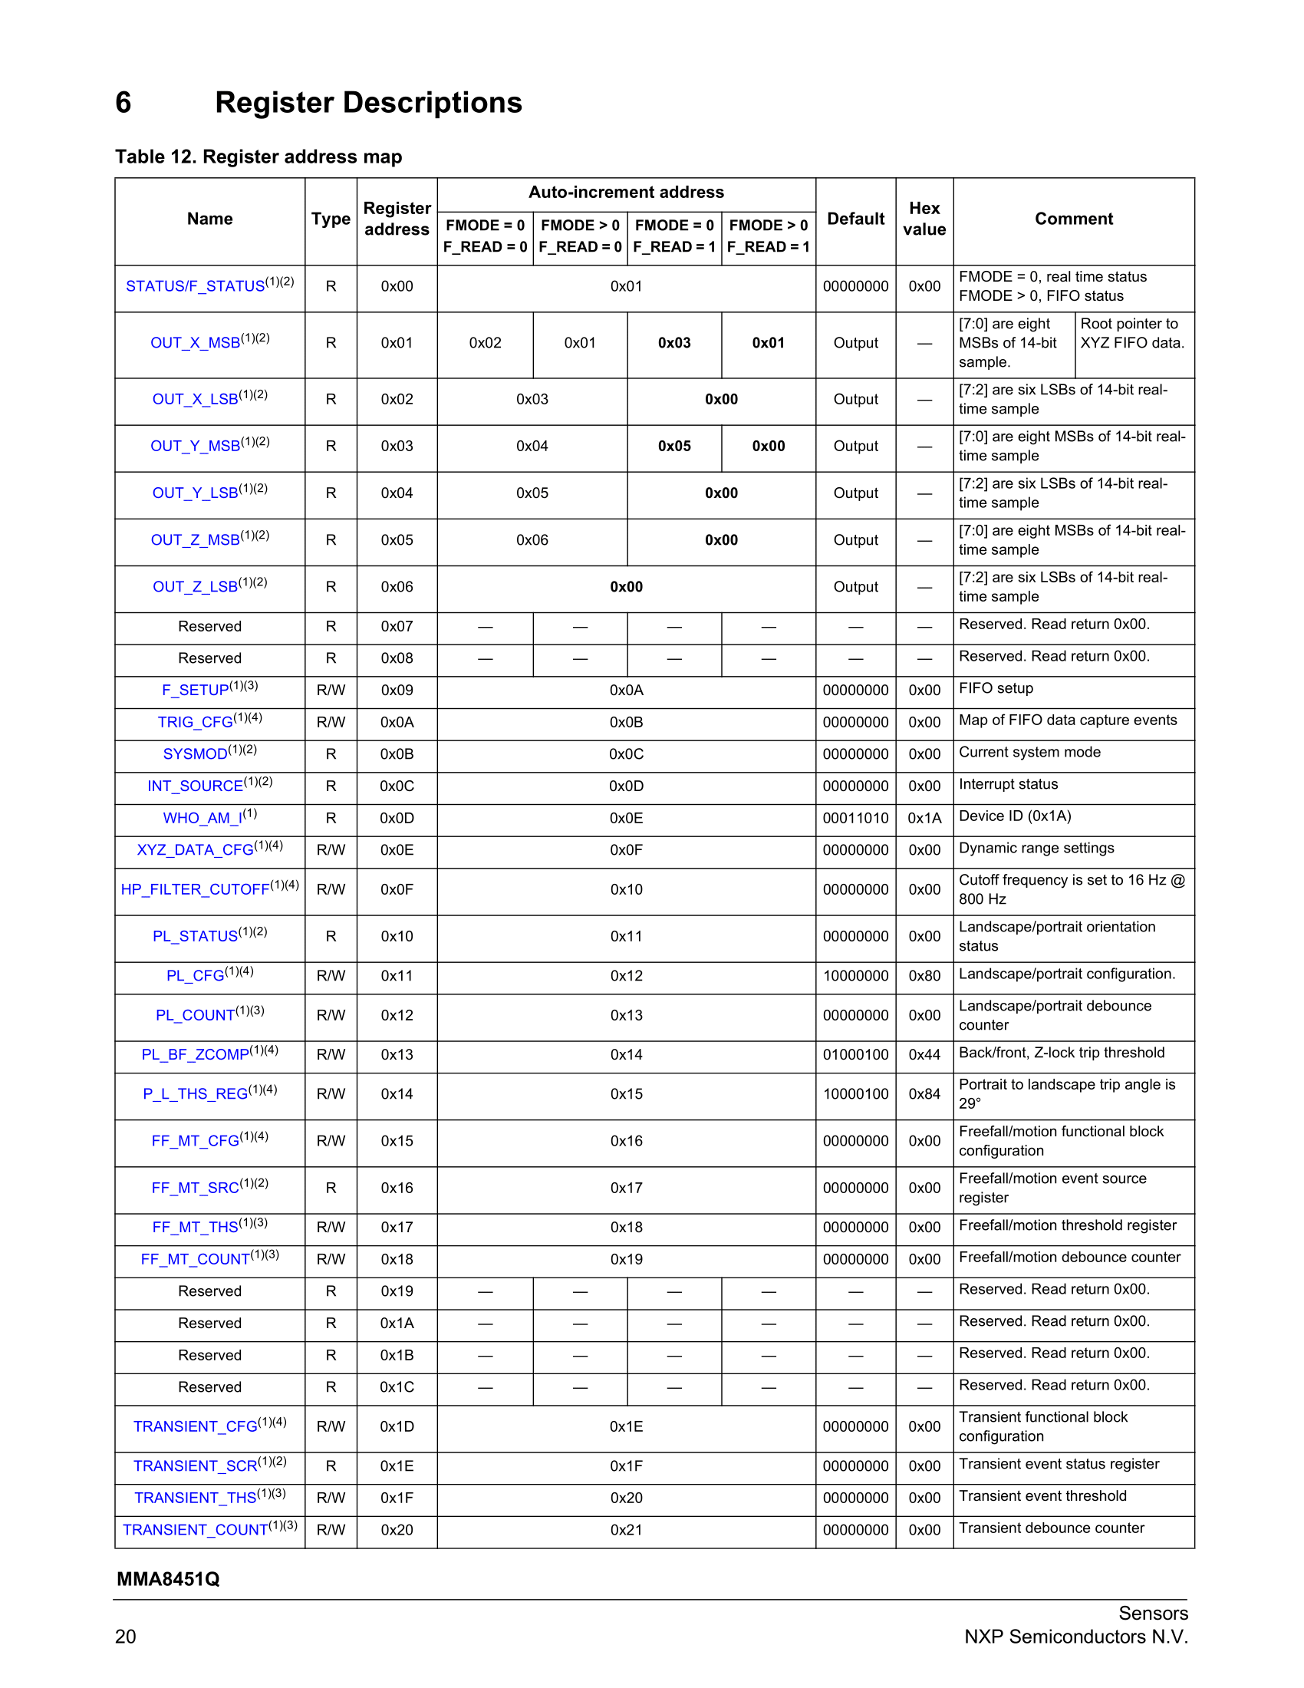
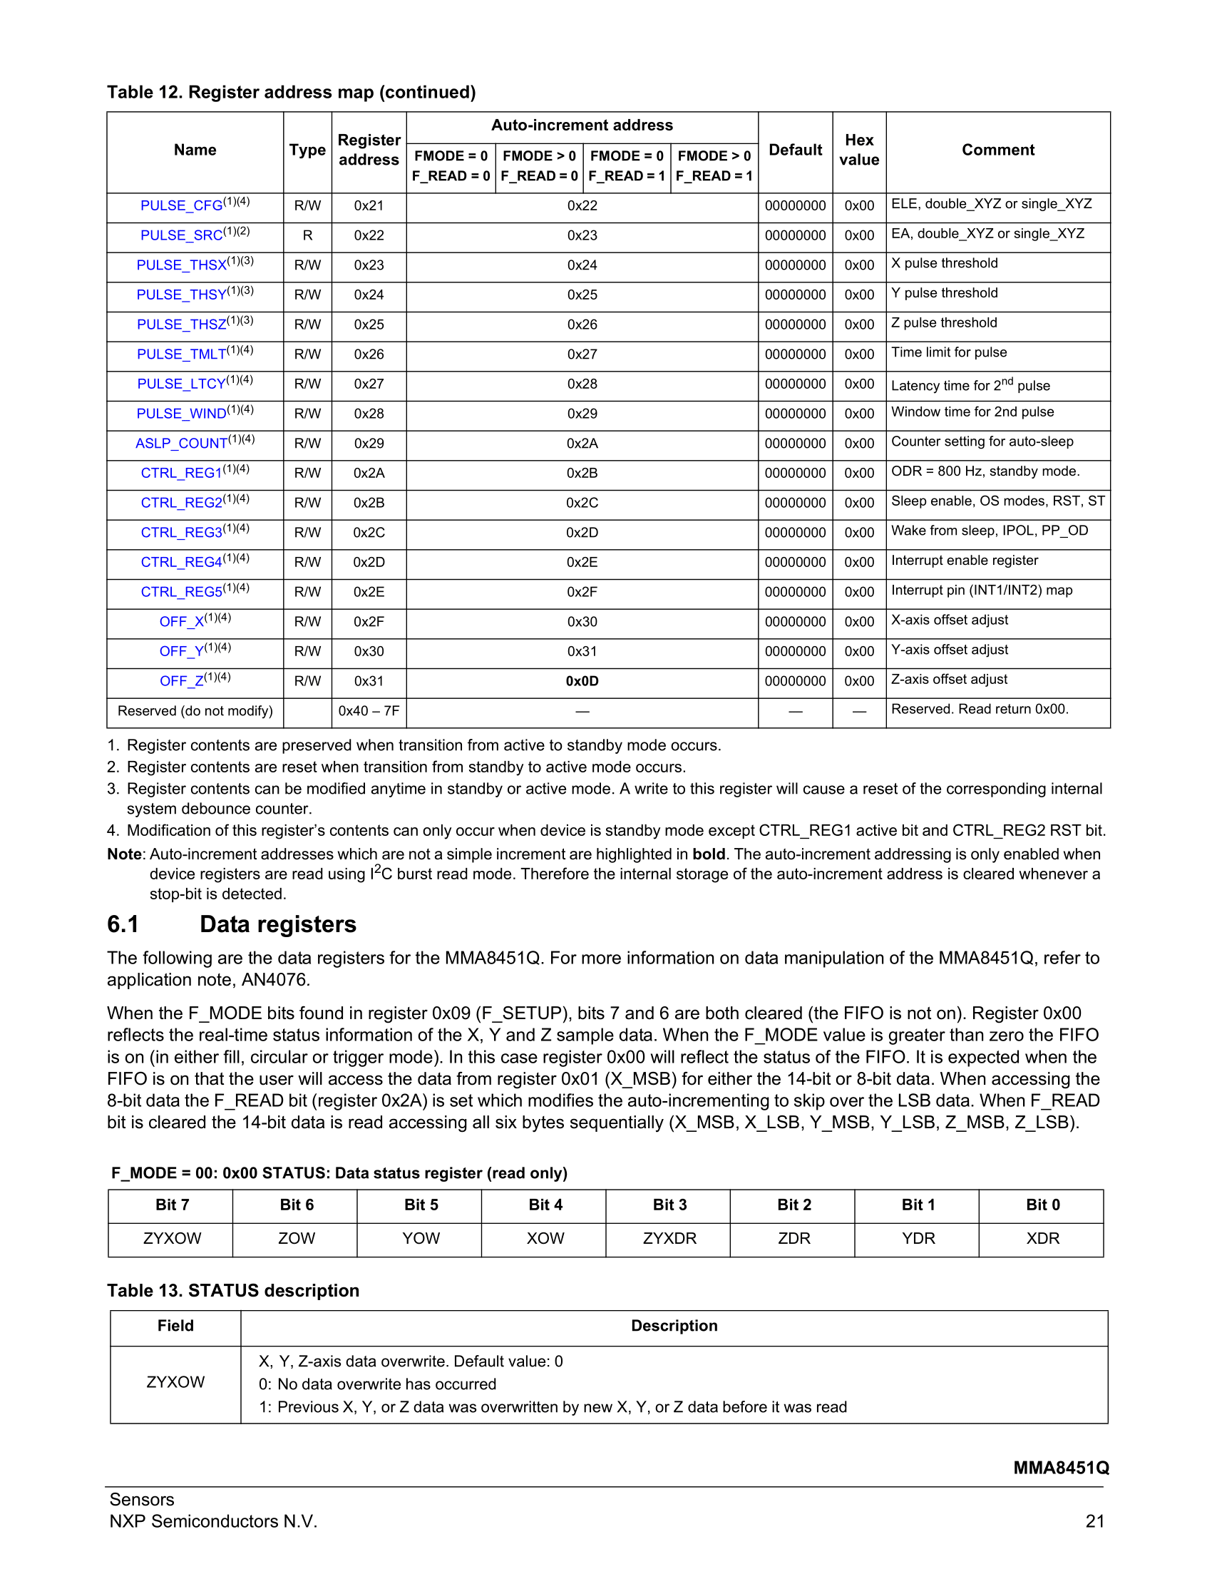

Slide 24
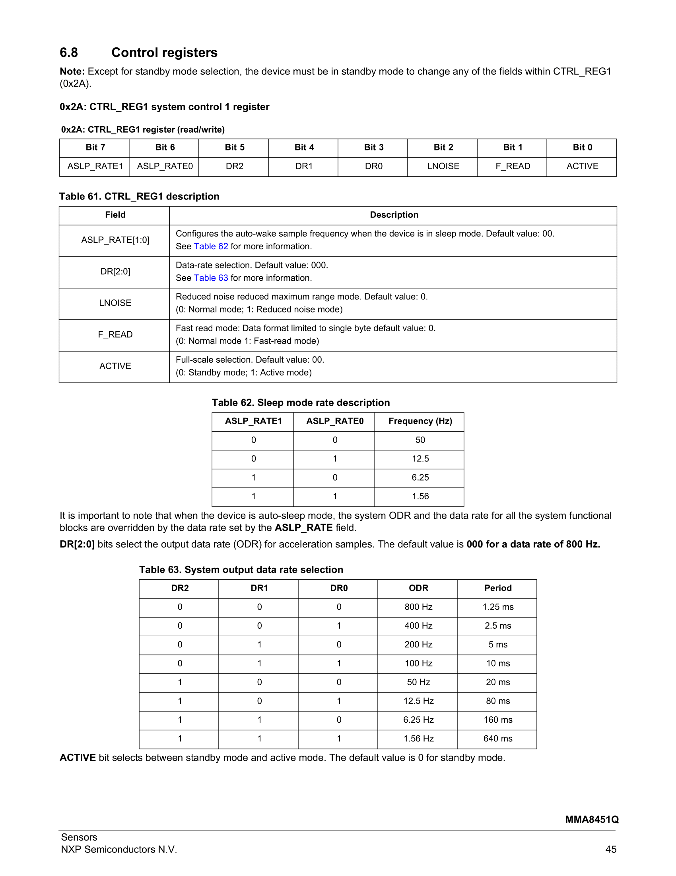
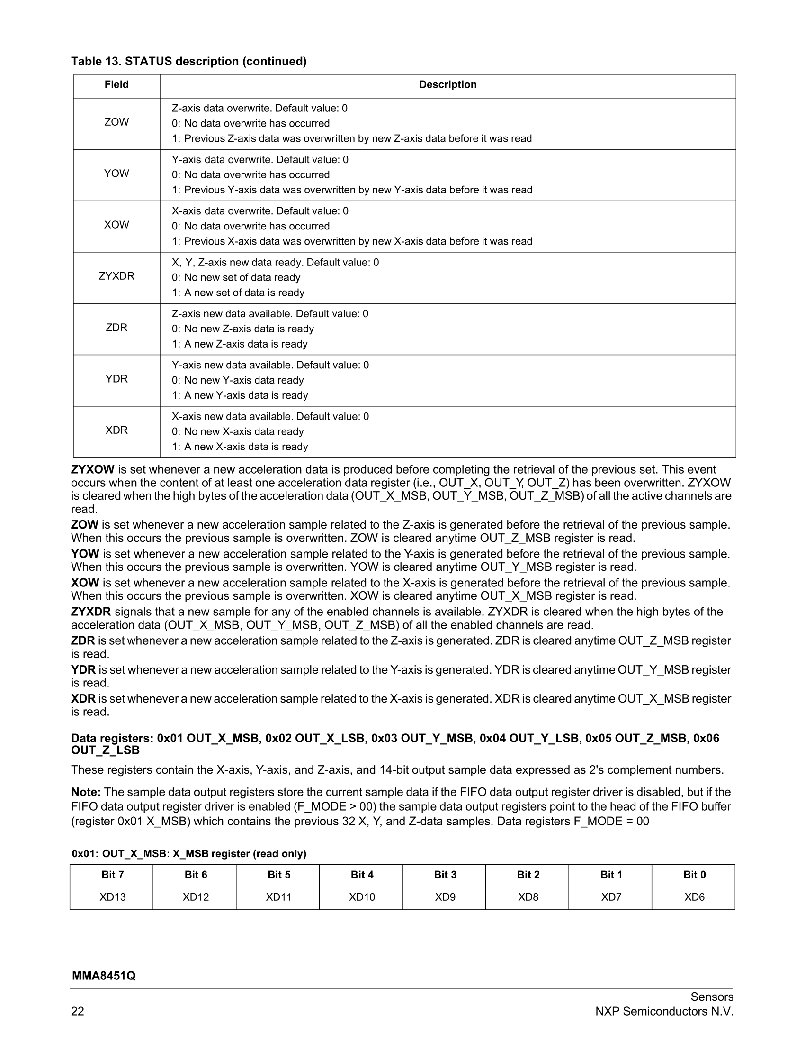
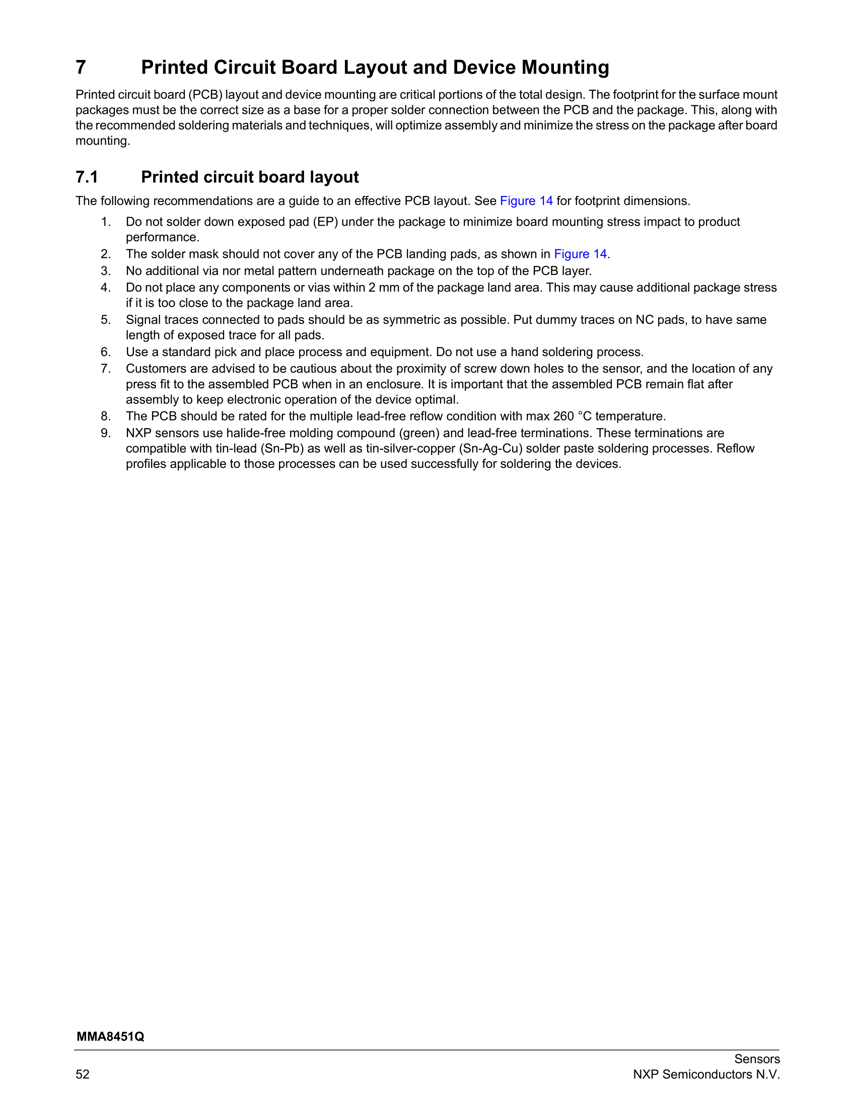
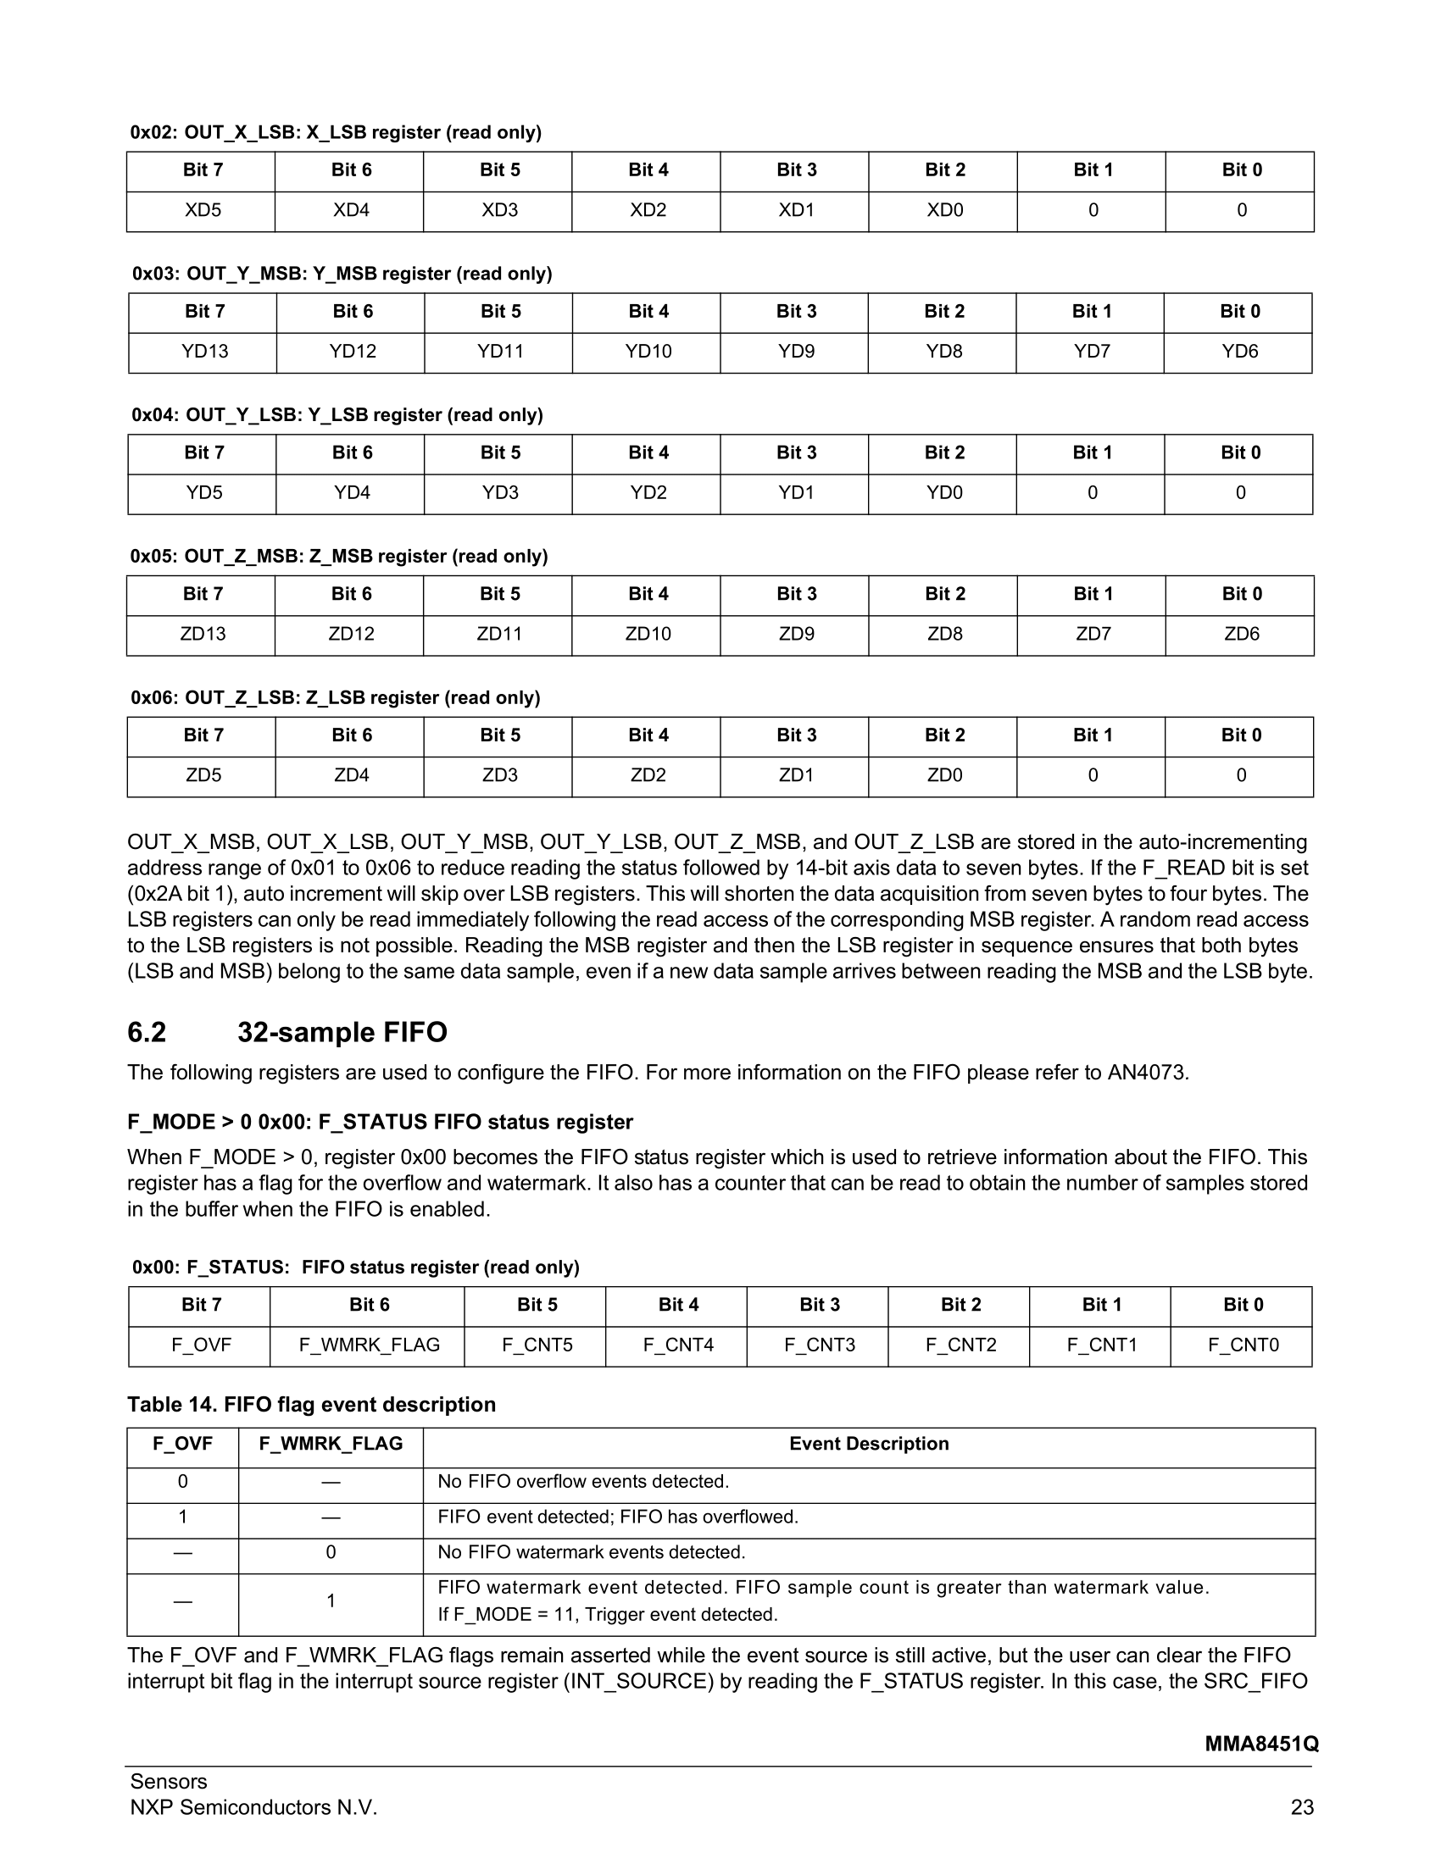
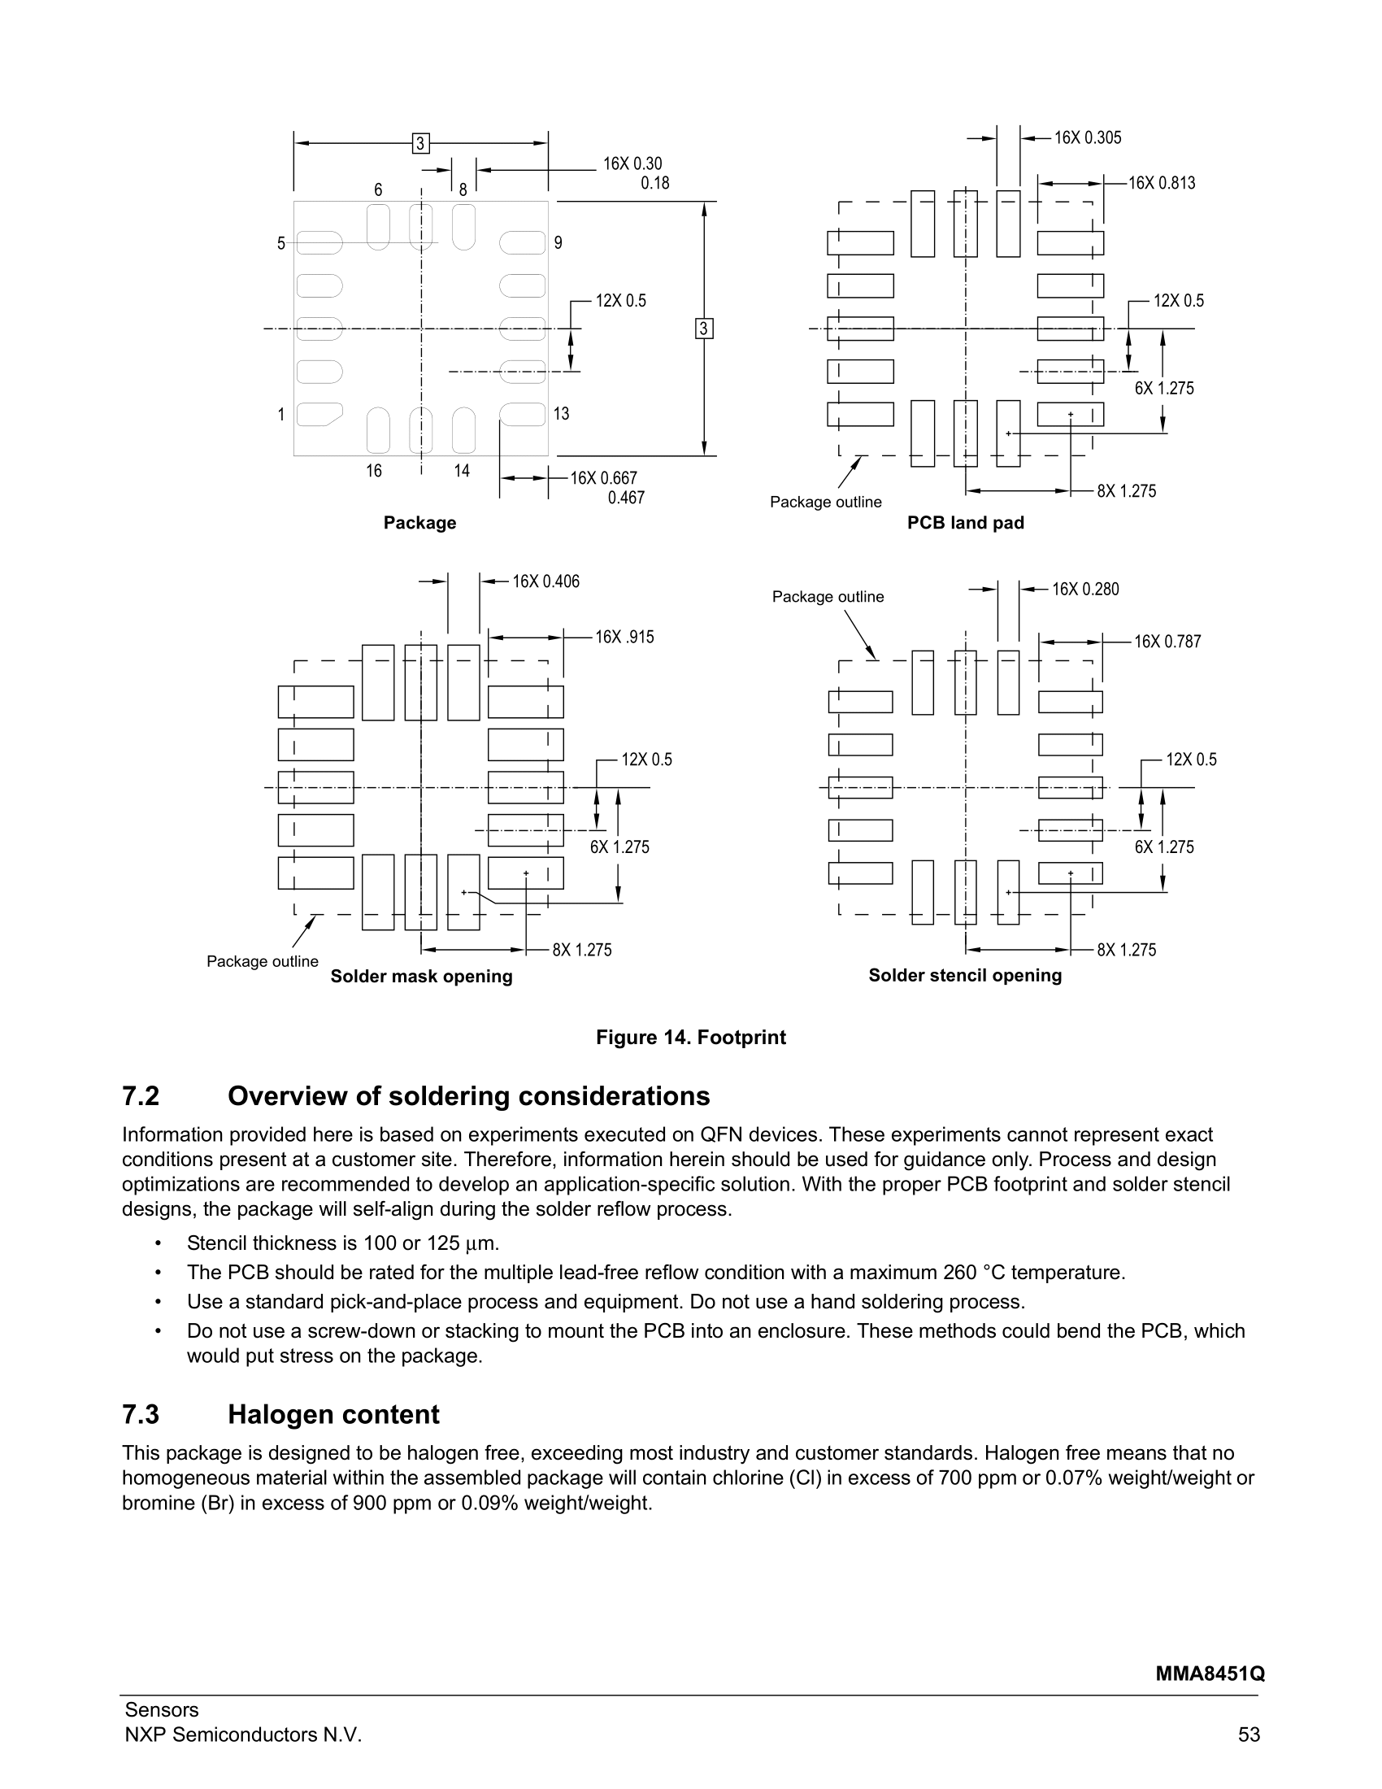































Slide 25
Putting Things
Together

Slide 26
Example Driver Initialisation

Slide 27
Example Driver Initialisation

Slide 28
Example Driver Initialisation

Slide 29

Example Driver Initialisation

Slide 30
Example Driver Initialisation

Slide 31
Code Tips
For constant values use const() for compiler optimisation
ustruct very useful to pack/unpack blocks of data to/from variables
Bitwise operations (>> << & | ^ ~) to target bits in registers
Need to be careful about memory allocation (including temp ones!)
Buffer preallocation for driver read data is more efficient
The gc and micropython modules can be used to control collection and profile memory
Documentation
http://docs.micropython.org/en/latest/reference/speed_python.html
http://docs.micropython.org/en/latest/reference/constrained.html

Slide 32
What if Something Goes Wrong?

Slide 33
Debugging 🐛
Check all connections and power supply
Double check all connections and power supply
Make sure all devices share ground
Make sure all devices have same logic level (5V vs 3.3V)
Reduce the data transfer speed
Find the simplest possible code example to replicate your issue
Search for application notes and other implementations
Search for erratas

Slide 34
Debugging 🐛
Capture and retrieve the data sent and received
Print debug
Hardware debuggers
SEGGER J-Link EDU Mini
Black Magic Probe
Some development boards have integrated debuggers
DAPLink, ST-Link, J-Link
Logic analyser
LEDs

Slide 35



Logic Analysers
Saleale is a nice entry level professional tool
SigRok (with PulseView) is an open source signal analysis software
Low cost SigRok-compatible devices start at £10

Slide 36
Let’s get coding!
https://github.com/carlosperate/micropython-driver-workshop
OR https://git.io/Je3tM

Slide 37

BBC micro:bit
User buttons
5x5 LED Matrix
Edge Connector

Slide 38


BBC micro:bit
Micro USB
Reset Button
2.4GHz Antenna
16 MHz Cortex-M0+
Bluetooth
Battery connector
Magnetometer
Acceleromater

Slide 39
Code Tips
For constant values use const() for compiler optimisation
VARIABLE = const(0x55)
ustruct very useful to pack/unpack blocks of data to/from variables
output_tuple = ustruct.unpack('b', b'\x55’)
https://docs.micropython.org/en/latest/library/ustruct.html
Bitwise operations (>> << & | ^ ~) to target bits in registers
Shit a bit 3 places to the left: result = 1 << 3
Set bit 3: result = original | (1 << 3)
Flip all bits: 0b11110111 = ~0b00001000
Clear bit 3: result = original & ~(1 << 3)
https://wiki.python.org/moin/BitwiseOperators

Slide 40
Summary

Slide 41
Summary
Peripherals inside the microcontroller are responsible for controlling specific hardware features
Hardware can be driven by setting or clearing bits in specific memory locations (registers) in your microcontroller or device
There are multiple protocols to talk with other devices
Datasheets documents what to send and what to expect
MicroPython driver code is similar, but different, than other Python code
Hardware is awesome, even more so with Python!

Slide 42
Summary
Peripherals inside the microcontroller are responsible for controlling specific hardware features
Hardware can be driven by setting or clearing bits in specific memory locations (registers) in your microcontroller or device
There are multiple protocols to talk with other devices
Datasheets documents what to send and what to expect
MicroPython driver code is similar, but different, than other Python code
Hardware is awesome, even more so with Python!

Slide 43
Other Serial Protocols
(Bonus Slides)

Slide 44

UART Protocol
Universal Asynchronous Receiver/Transmitter
2 unidirectional digital serial data lines
Optional 2 control signals
Baud-rate predefined for both devices
For new boards, good 1st driver to get working
UART-to-USB bridges/cables are very common
Similar standards:
RS232 / RS485
ISO7816 (Smart cards)

Slide 45

UART Protocol
Simple format:
1 start bit
5-9 data (usually 8)
1 (or 0) parity bit
1 (or 2) stop bits
from machine import UART
uart = UART(1, baudrate=9600,
bits=8, parity=None,
stop=1)
uart.write(b'\xAA')
From SparkFun Serial Communication tutorial https://learn.sparkfun.com/tutorials/serial-communication/all

Slide 46

SPI Protocol
Serial Peripheral Interface
Synchronous serial protocol
4 wires (+1 for each extra slave):
Master-Out-Slave-In shared with all
Master-In-Slave-Out shared with all
Clock shared with all devices
Slave Select individual signal per slave
Clock frequencies can be in the MHz range

Slide 47

SPI Protocol
from machine import SPI
spi = SPI(1, SPI.MASTER,
baudrate=600000)
data = spi.send_recv(b'S')
From SparkFun SPI tutorial: https://learn.sparkfun.com/tutorials/serial-peripheral-interface-spi/all

